Slide 1
Modelling the GRB light curves using a shock wave model
Saša Simić
Luka Č. Popović
Luca Grassitelli

Slide 2
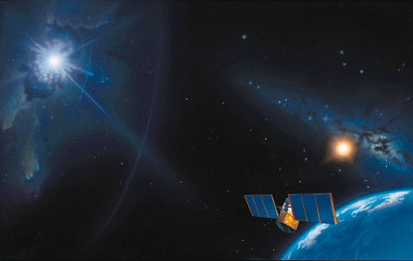
GRBs – Strongest explosion in the Universe
Artist expression

Slide 3
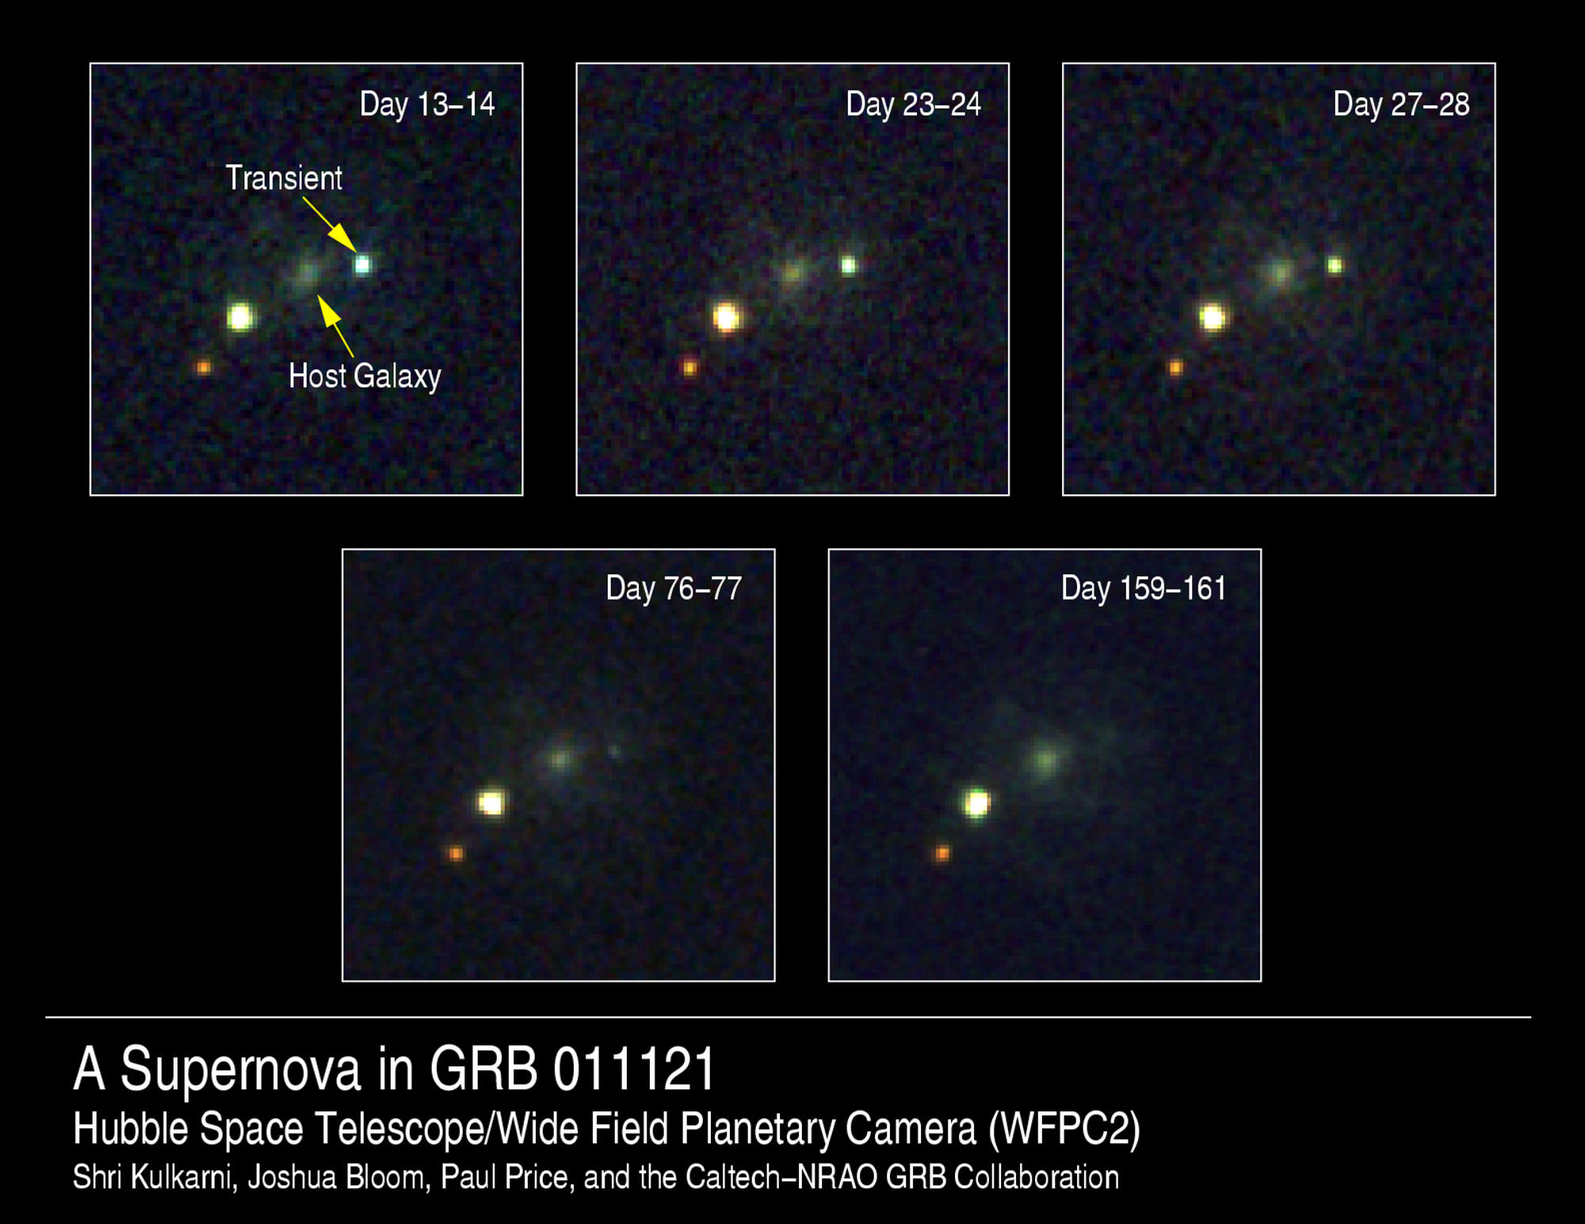
What do gamma ray bursts actually look like?
GRB011121

Slide 4
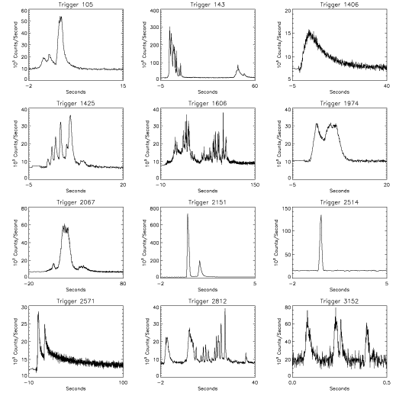
What do gamma ray bursts actually look like?
J.T. Bonnell (NASA/GSFC)

Slide 5
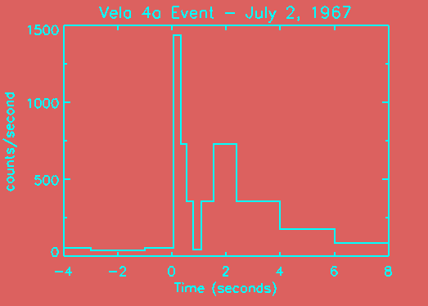
GRBs - Discovery (1967-1973)
US Vela Nuclear test detection satellites
Notes:
Vela satellite at 65,000 miles (above Van allen belt-> reduce noise + detect soviet test on the moon)
Data were first files away !!
2 more generations of satelite to determine not from sun, moon, planet

Slide 6
GRB, tell me who you are…
GRBs remained a complete mystery for almost 30 years !
More than 150 different theories:
  Magnetic flares
  Black Hole evaporation
  Anti-matter accretion
  Deflected AGN jet
  Magnetars, Soft Gamma-Ray Repeaters (SGRs)
  Mini BH devouring NS
  messages from the Aliens
  …..
Notes:
Search for host / counterparts in other wavelength BUT bad localization
-> IPN network

Slide 7
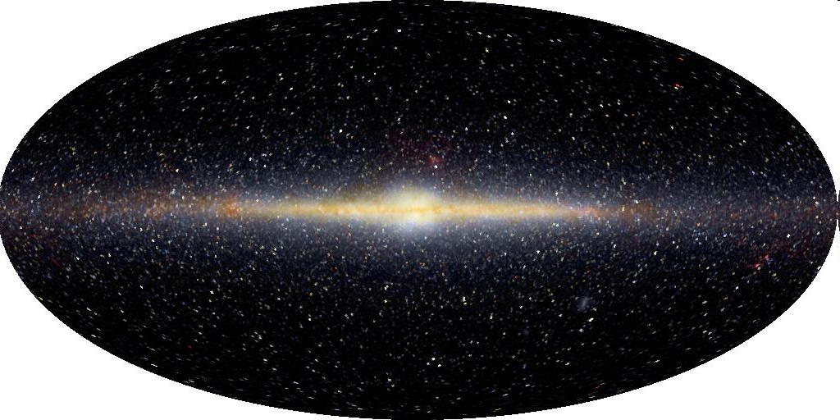
Are they in the Milky Way galaxy?
If gamma ray bursts are in the Milky Way, what would the map look like if we put a dot everywhere a gamma ray burst has been observed?
COBE

Slide 8
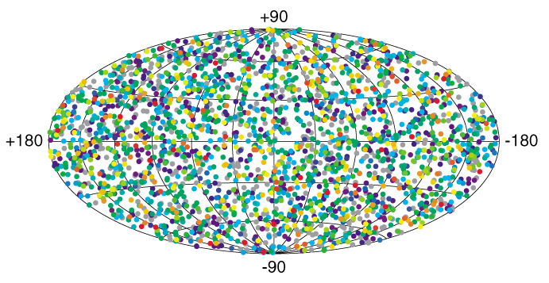
Gamma ray burst locations
Gamma ray bursts observed by the BATSE instrument on the Compton Gamma Ray Observatory
(about one gamma ray burst per day was observed)
COBE

Slide 9
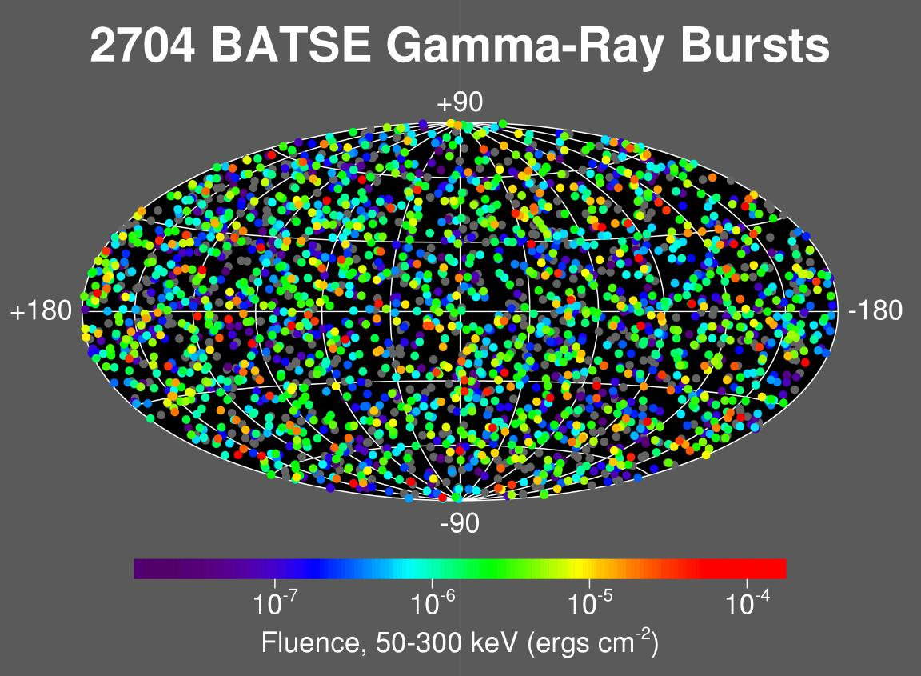
BATSE results
Isotropic distribution:
-> rules out most galactic models
Notes:
Energetics favor a galactic origin

Slide 10
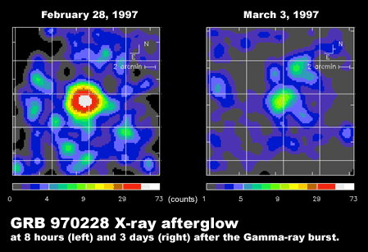
Galactic vs Cosmological origin
BeppoSAX: GRB 970228
1st X-ray/Optical afterglows detected
Host galaxy was identified at z ~ 0.7 !
GRBs are extragalactic !
Notes:
Story of HETE that was supposed to be launched in 1994
Afterglow detected from emission/absorption lines of the spectrum of the galaxy

Slide 11
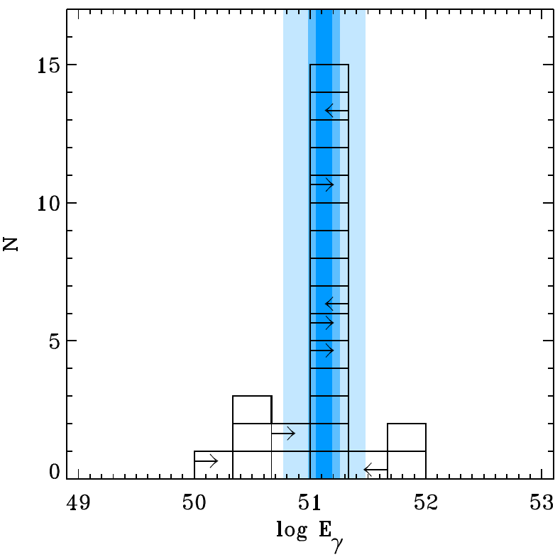
How do we know how much energy a gamma ray burst has?
We measure their distance and how bright they appear
(far away and bright → lots of energy)

Slide 12
Consequence of cosmological origin of GRBs
Tremendous isotropic-equivalent energy:
  10⁵⁰ -10⁵⁴ ergs released in a short time scale only in the form of gamma-rays.
(sun: 10³³ erg/sec; supernova: 10⁵¹ ergs on a month time scale)
GRBs have been observed up to z ~ 6.3
-> hope to use GRB as cosmological tool (similar as Type Ia supernovae)

Slide 13
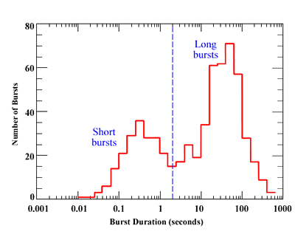
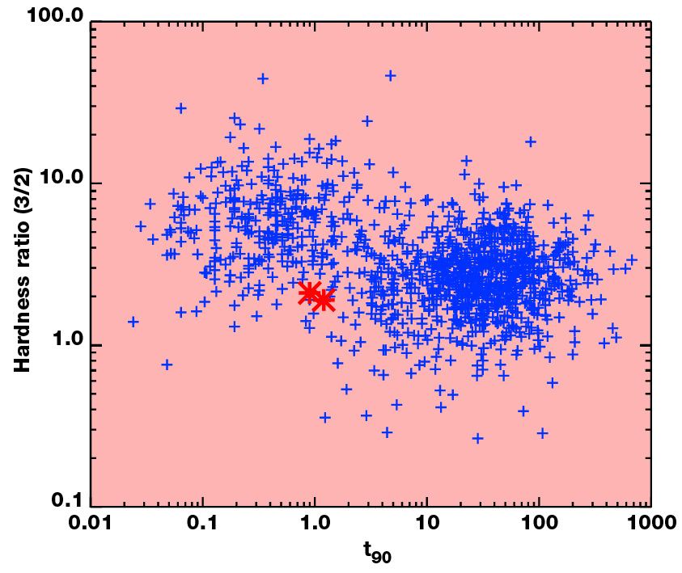
BATSE results
2 populations of GRBs:
  Short-Hard / Long-Soft Bursts
Burst duration
Hardness-duration diagram

Slide 14
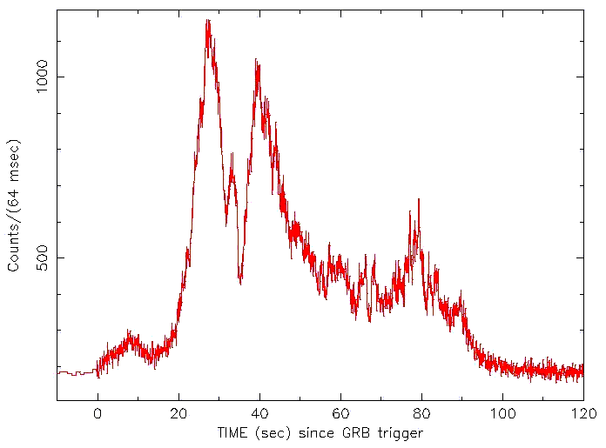
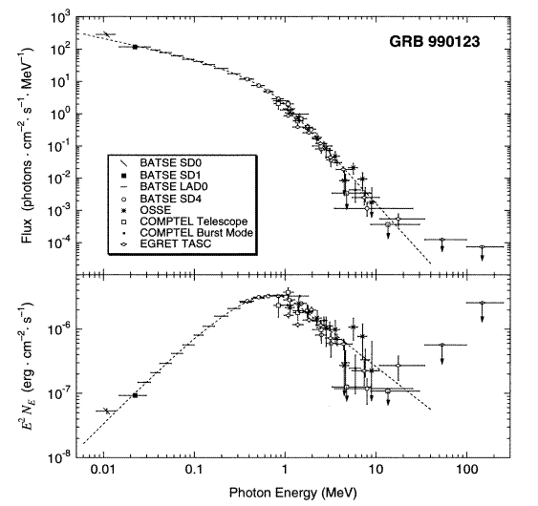
GRB lightcurve / spectrum
Non thermal prompt emission
Best spectral fit: smoothly joining broken power law
Compactness problem:
  Emitting region optically
  thin if emitting material
  has Lorentz factor > 100
  -> Ultrarelativistic outflow
  (fastest bulk flow in the
  universe)
Briggs et al. 1999

Slide 15
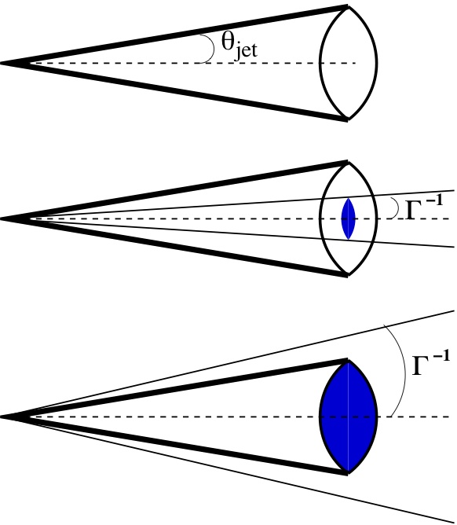
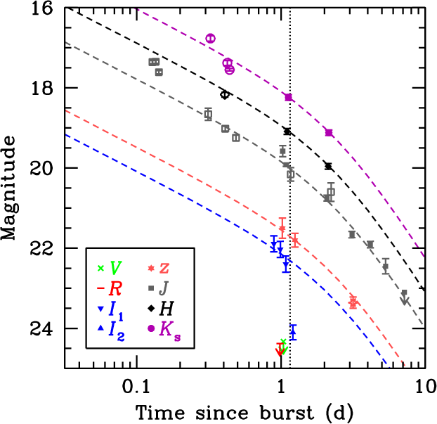
Evidence of a jet
Energetic argument: the release of isotropic energy in the form of gamma-rays is a real theoretical nightmare
Evidence of jet-like emission in the optical afterglow lightcurve (but not so widespread):
Rate of GRBs ~ 1 GRB/galaxy/100,000 years

Slide 16
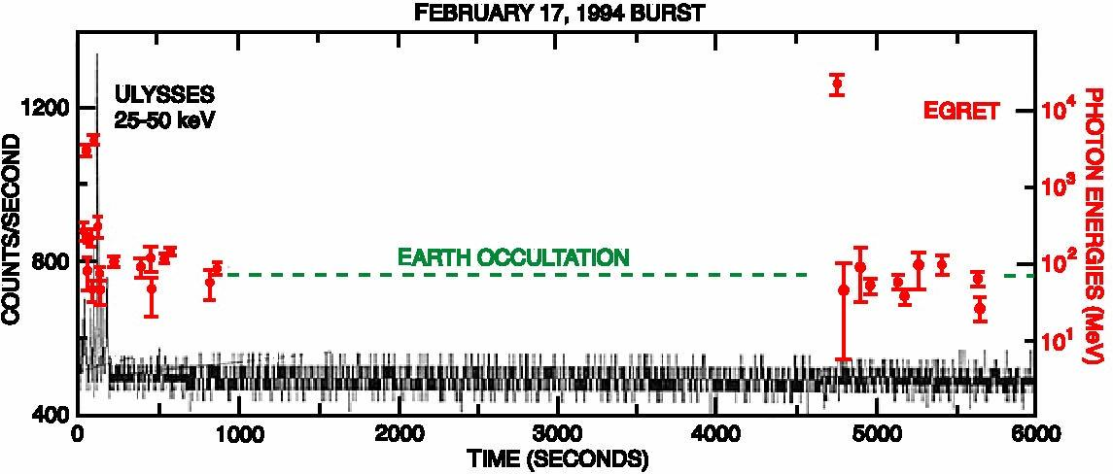
High energy behavior
Little is known about GRB emission above 10 MeV
EGRET detected a handful of burst but statistics is quite poor to draw any conclusions from it.
GRB940217: 18 GeV photons detected up to 90 minutes after trigger

Slide 17
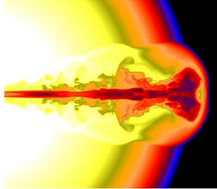
Progenitors
Long-Soft bursts: Collapsar model
  Death of a massive (> 40 Msun), rotating stars.
    Massive for a core-collapse forming a BH
    Rotating to drive a pair of jet along the rotation axis

Slide 18
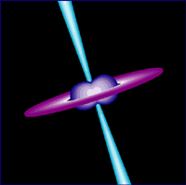
Progenitors
Short-Hard Bursts: NS-NS (NS-BH) merger
  NS-NS (NS-BH) in a binary system will loose energy through gravitational waves
  The 2 objects will get closer until tidal forces rip the NS apart and matter falls into a BH.
  The process has ms timescale
Evidence for the merger model are less striking:
Afterglow localized outside older galaxies
Good candidate for gravitational wave detection
Other progenitor still possible (giant magnetar flares…)

Slide 19
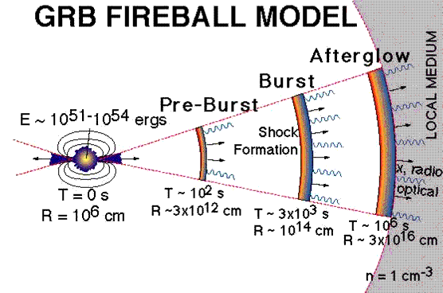
Fireball model
Prompt outburst phase (gamma-ray/x-ray): internal shocks in the relativistic blast wave.
Afterglow (x-ray, optical, radio):
external shock of the cooling fireball with the surrounding medium.
Note: this is independent of the type of progenitor
Note 2: this is just the leading candidate (for good reasons?), many more are out there…
Notes:
Hadronic vs leptonic content

Slide 20
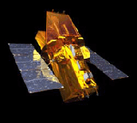
What’s now?
Swift :
  Very fast X-ray/optical afterglow observations
  Short GRBs
Naked eye bursts:
  Peak magnitude ~ 5.8
TeV telescopes (Magic, Veritas, HESS…), gravitational wave interferometers (LIGO, LISA), Neutrino detectors (Amanda, ANTARES…)
Notes:
Theoretically visible to human eye for 30 sec

Slide 21
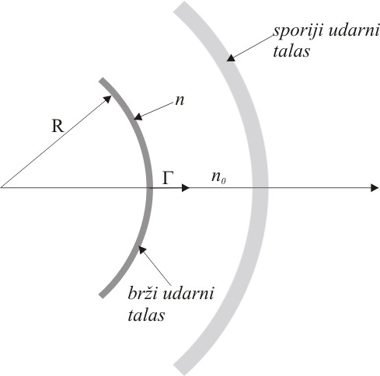
Phenomenological shock wave model
This model does not put any constraints on the progenitor itself.
We evolve three most important parameters R, Γ, m.
Those eqs. describe the incoming shell.
Equation for n give a shell density (see Blandford & McKee, 1976.)

Slide 22
Phenomenological shock wave model
We suppose density perturbation has gaussian distribution.
Density barrier is non-stationary.
Electrons in the excited shells follow power law distribution.
Parameters a and b determine shape of the barrier, height and width, respectively .

Slide 23
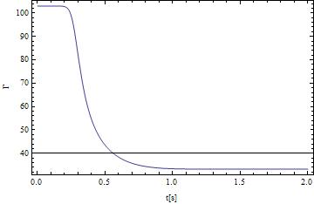
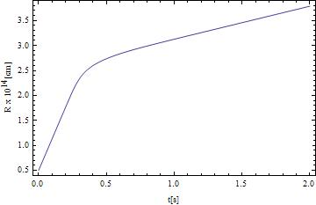
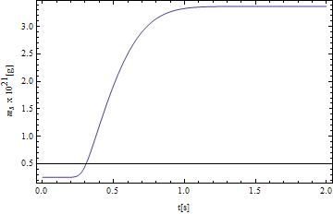
Phenomenological shock wave model
Sharp decrease/increase of the evolved variables during the collision.

Slide 24
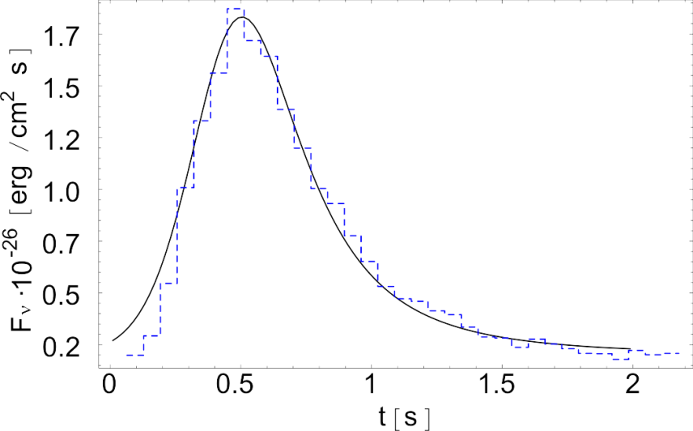
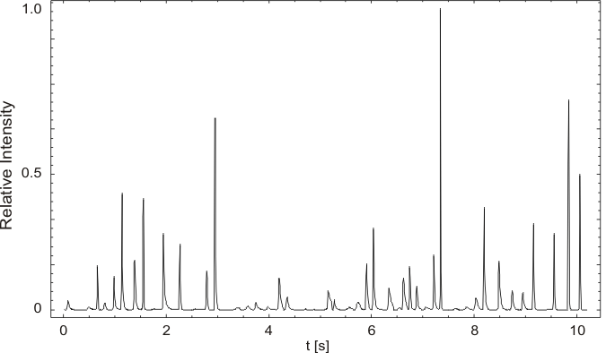
Phenomenological shock wave model
Conversion of kinetic energy in to radiation by means of synchrotron emission.
Inverse Compton effect also take some part of spectra, mostly on higher energies.
By relative motion in the reference frame of the shell magnetic field is induced.

Slide 25
Results and discussion
Some statistics can be drawn from the fitting of the sample.
Distribution of shock wave model parameters: Γ0, Γb, Rc, Mej, no, for the sample of 30 BATSE GRBs.

Slide 26
Results and discussion
Possible correlation of some of the parameters:

Slide 27
Results and discussion - conclusion
(i) Relativistic shell parameters obtained from the fitting of GRB light curves are in a good agreement with expected ones and also with estimations given earlier by other authors.
(ii) The obtained values of internal shell physical parameters for GRBs with different light curves are in the short interval, showing that the physical processes behind the GRB creation are similar, i.e. there should be the ejected mass that collides with surrounding regions — or accumulated slow moving material.
Also, we analyzed possible connections between parameters obtained from the best fitting of GRB light curves with measured ones. From this analysis, we can conclude:
(i) There is no strong correlation between parameters obtained from the best fitting, only some indication that long GRBs have higher values of Lorentz factor, and we found a slight trend between Lorentz factor of the shell and moving barrier for short pulses.
(ii) There is a correlation between the intensity of pulses and the energy density of the shell only for a low energy pulses [Γ0 Mej < 0.2].
(iii) The FWHM of GRB light curve pulses is in the correlation with the width of the barrier. Using this, we give a relation between FWHM (that can be measured from observed light curves) and ΔR that is a parameter of the model.

Slide 28
Thank you

