Slide 1
Results from AGN multiple wavelength observations and
the importance of monitoring campaigns
G. La Mura D. Ilić
S. Ciroi L. Č. Popović
V. Cracco P. Rafanelli
24 – 28 April 2012, Andrevlje, Republic of Serbia

Slide 2
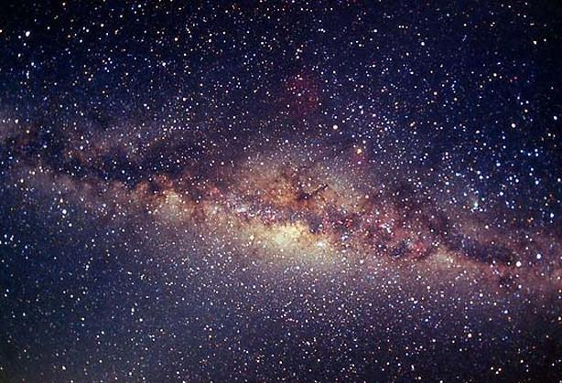
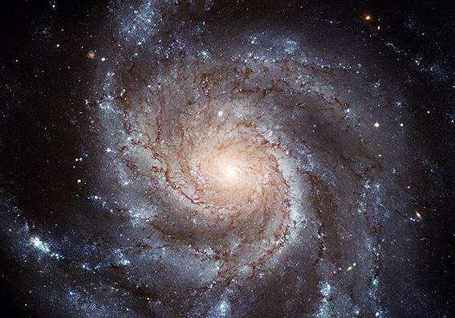
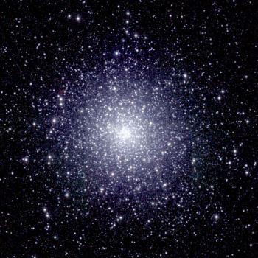
Why Active Galactic Nuclei?
The Milky Way, our Galaxy
M 101, a spiral galaxy
47 Tacanae, a Globular Cluster
… and the Sun, of course!

Slide 3
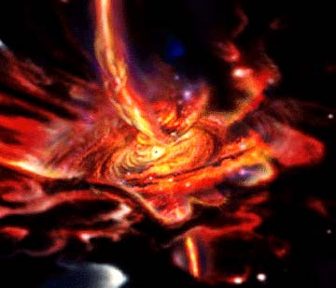
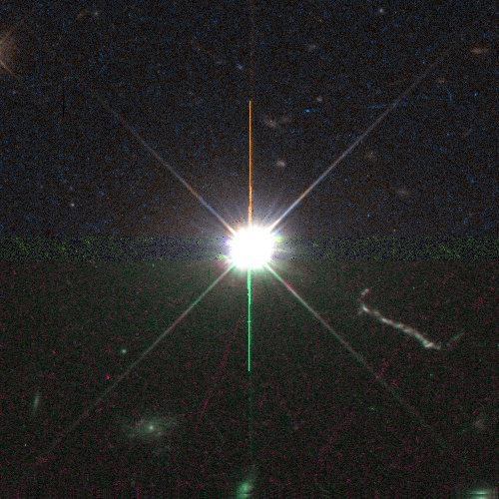
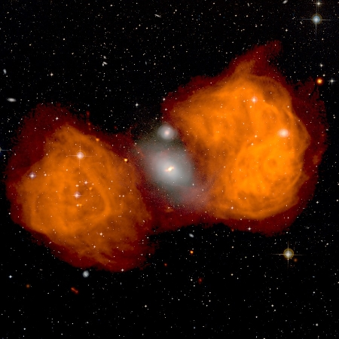
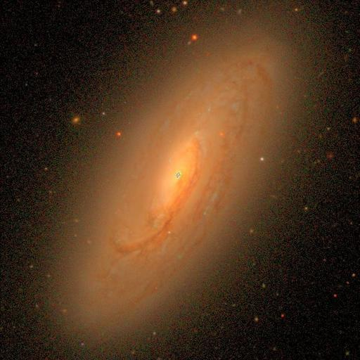
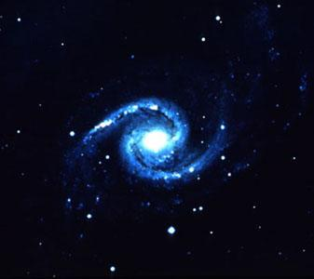
Active Galactic Nuclei: the Broad Line Region
3C 273, QUASAR
NGC 1316, Radio Galaxy
The main common feature of all the AGN classes is the large amount of energy released by the nuclear region of the active galaxies.
There is convincing evidence that the ultimate source of power is always the same: a Super Massive Black Hole, located in the centre of these galaxies, which is accreting large amounts of fuel from the surrounding space.
NGC 1566, Seyfert 1
NGC 1566, Seyfert 2

Slide 4
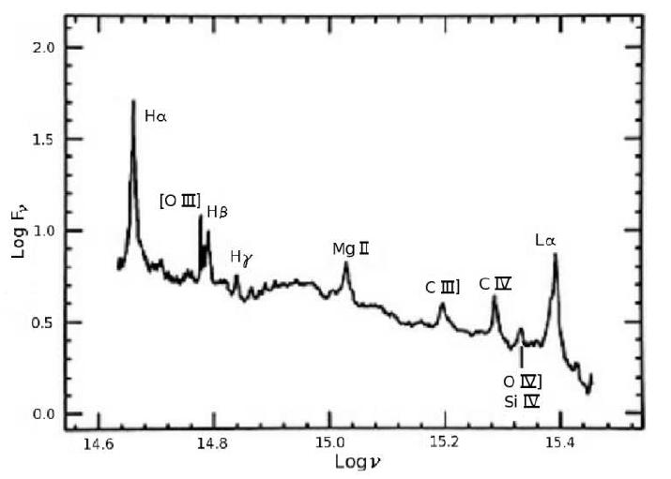
Physics of the BELR
A typical Type 1 AGN spectrum (from Netzer 1990)

Slide 5
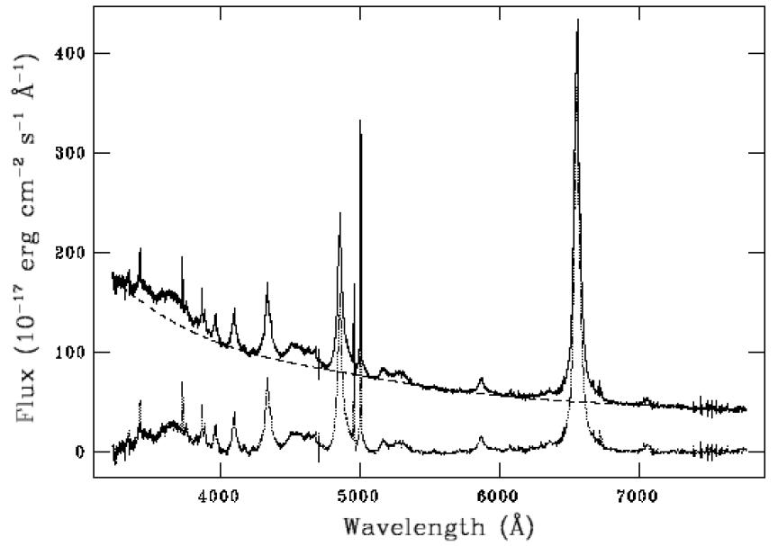
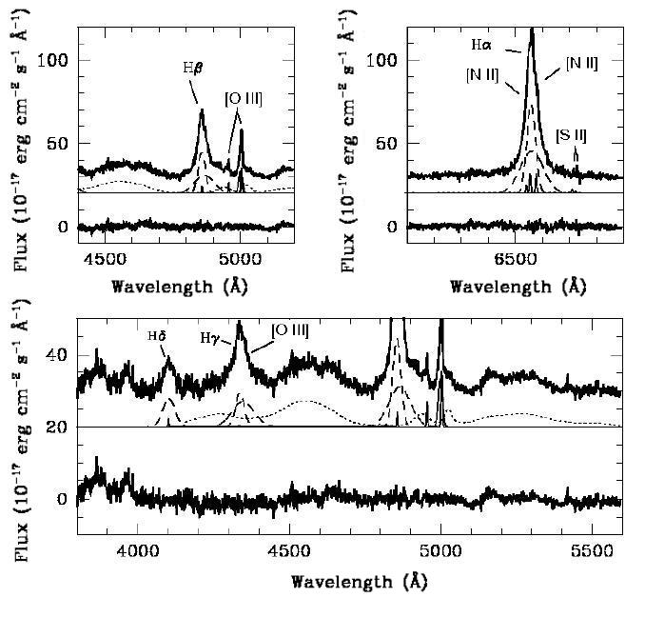
The optical domain: continuum and emission lines
The identification of the broad spectral line component may be carried out by means of standard techniques, such as the multiple Gaussian profile fits, as it is shown in the case of PG 1014+4717 below.
Spectroscopic observations carry several contributions, which are blended together with the BELR signal and must be accounted for, in order to study the broad emission lines. This example illustrates the subtraction of the underlying continuum in the spectrum of 2MASS J03221390+0055134.

Slide 6
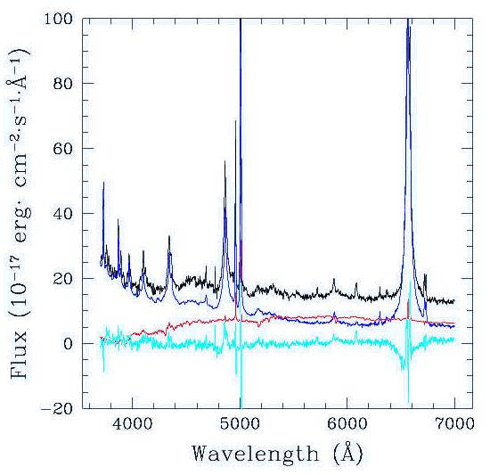
The optical domain: continuum and emission lines
Host galaxy correction and iteration
INPUT
OUTPUT
Observed spectrum
No, the host is wrong!
Host spectrum
LEAST
SQUARES
FIT
Yes
Best
Fit
Eigenvalues
Galaxy Eigenspectra
Physical solution?
AGN Eigenspectra
AGN spectrum
No, the AGN is wrong!
AGN correction and iteration
A principal component analysis technique, based on iterative fits to observational data, was developed to isolate the AGN contribution from host galaxy contamination in the SDSS spectra
Connolly et al. 1995, AJ, 110, 1071
Yip et al. 2004, AJ, 128, 585
Yip et al. 2004, AJ, 128, 2603

Slide 7
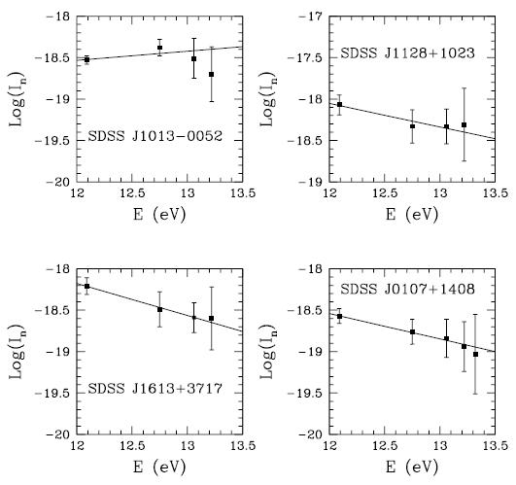
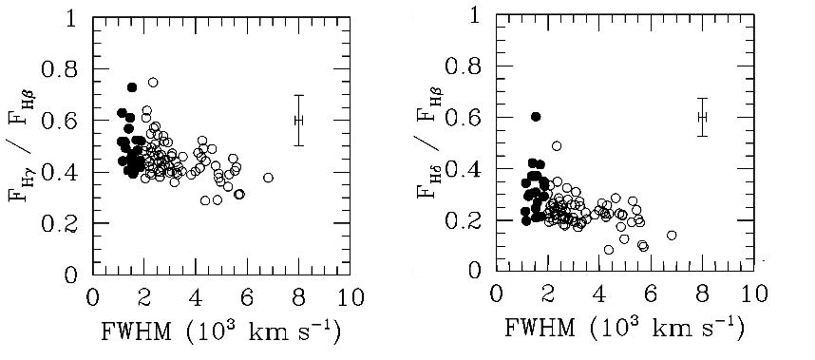
Plasma diagnostics with Boltzmann Plots
The Boltzmann Plot: given the normalized line intensity
the logarithm of I_{n} for a particular transition series, in an optically thin plasma, is a linear function of the upper level’s excitation energy, with a slope that depends on the plasma electron temperature

Slide 8
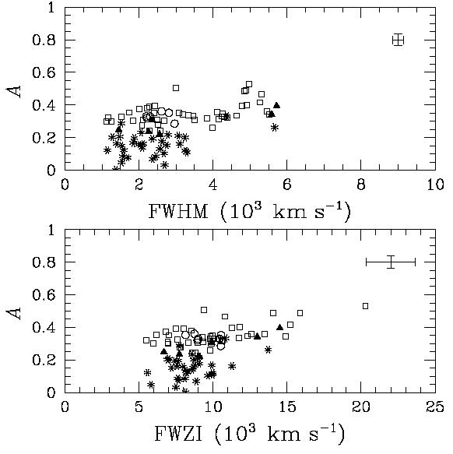
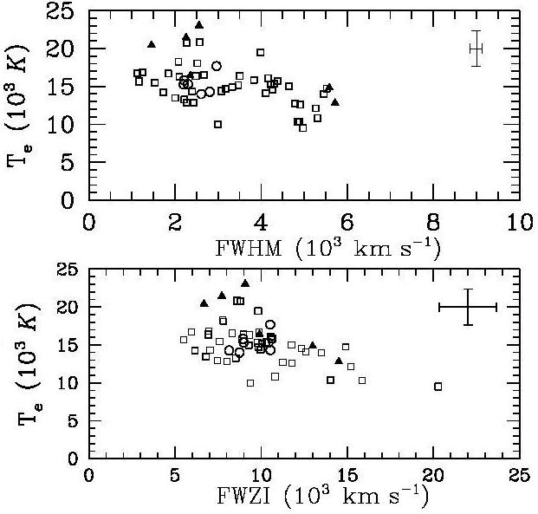
Plasma diagnostics with Boltzmann Plots
Boltzmann Plot slopes as a function of line profile widths (left panel), with the corresponding plasma temperature estimates (right panel).
The Boltzmann Plot assumptions only hold in a fraction of the selected AGN sample (~ 30%), preferably in the range of broad line emitting sources. In narrow lined objects the analysis points towards stronger ionization and higher plasma temperatures (La Mura et al. 2007, ApJ, 671, 104)

Slide 9
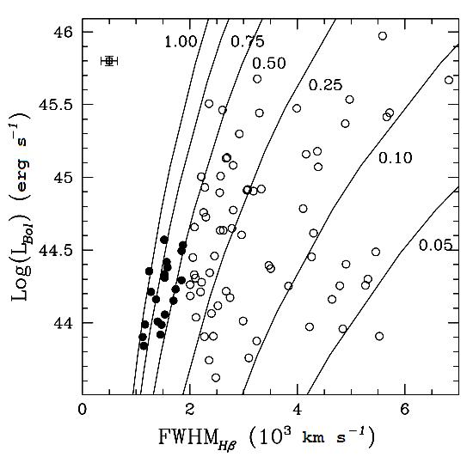
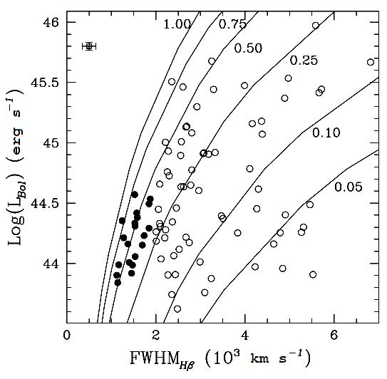
Plasma diagnostics with Boltzmann Plots
Bolometric luminosities vs. FWHM(Hβ) according to the structural models of Kaspi et al. (left panel) and Bentz et al. (right panel). Filled circles are NLS1 galaxies, while the continuous lines represent SMBH, having masses in the range from 10⁶ M to 10⁹ M and accreting at the labeled Eddington ratios. These observations suggest that objects with narrow emission lines are more commonly powered by low mass black holes working at very high accretion rates.

Slide 10
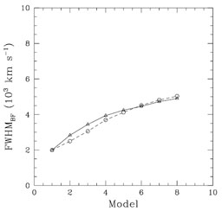
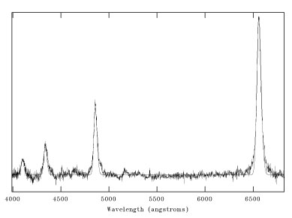
The emission line profiles
Spectrum of PG 1014+4717
1.5 ∙ 10⁸ M
i = 10°
10⁷M
i = 10°
10⁷ M
i = 45°
Given the complex structure of the emission line region, however, the connection among the broad line profiles and the source kinematics is not straightforward. Here we introduce a composite broadening function (BF) based on the Gauss-Hermite polynomial expansion:

Slide 11
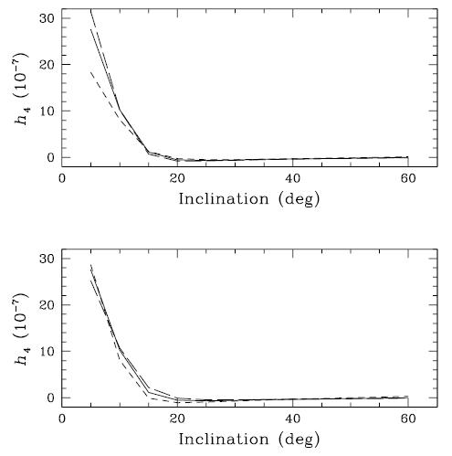
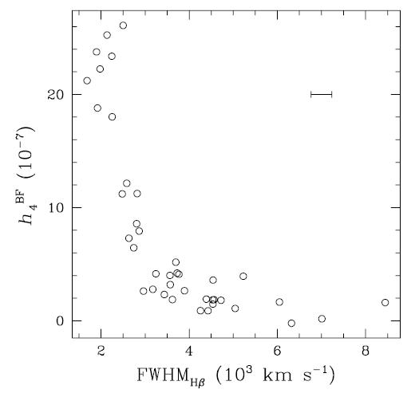
The emission line profiles
Reference Model
Dominating Disk
Faint Disk
Reference Model
High σ_{v}
Low σ_{v}
The observed line profile moments are in very good agreement with the predictions of some composite BLR structural models, involving two distinct kinematical contributions: a flat rotating disk, embedded in a surrounding distribution of line emitting material. The inclination of the disk is the main factor affecting the emission line kurtosis.

Slide 12
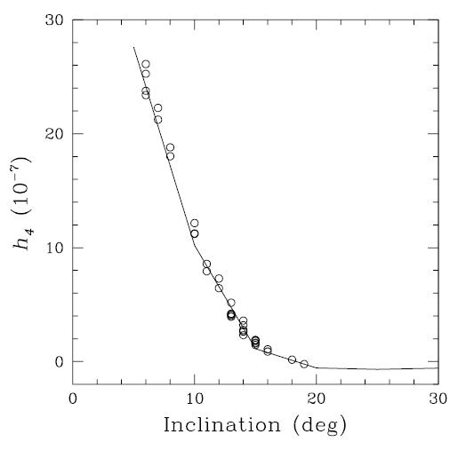
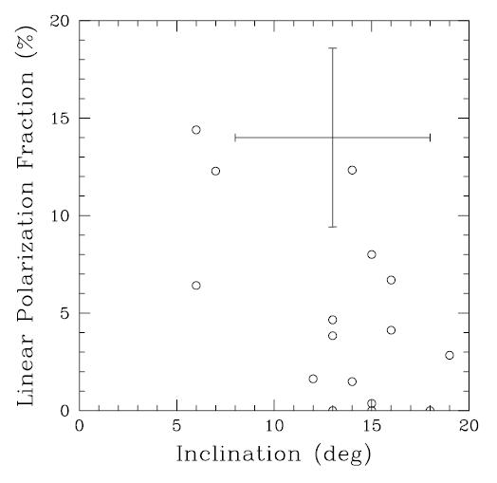
The first test: radio observations
Degree of linear polarization in the radio observations of Type 1 AGN as a function of the inferred BLR inclination with respect to the observational line of sight.
Inclination of BLR, with respect to the line of sight, estimated from the line profile kurtosis predicted by complex BLR structural models, allowing for the existence of a flattened component.

Slide 13
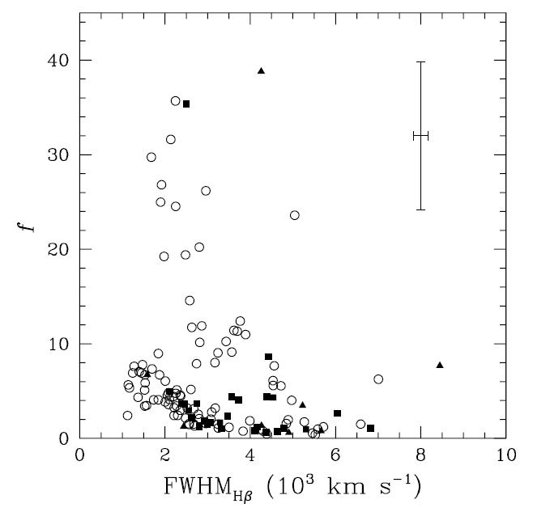
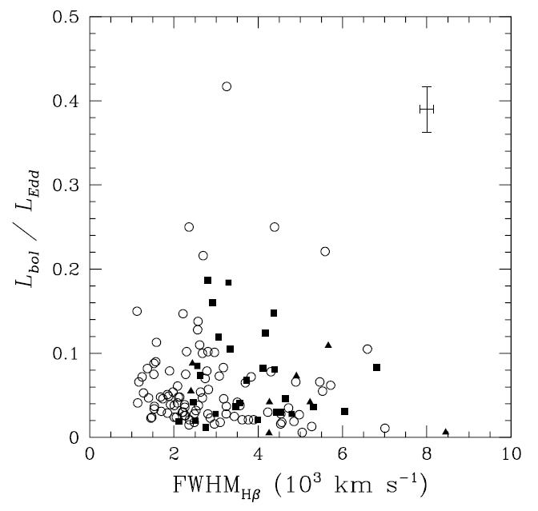
The emission line profiles
Left: Geometrical factors to estimate the SMBH mass from the profile of Hβ.
Right: Accretion rates onto the SMBH, given in terms of Eddington ratios, as a function of the corresponding FWHM_{Hβ} (from La Mura et al. 2009, ApJ, 693, 1437)

Slide 14
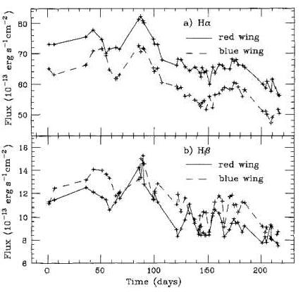
Optical monitoring and Reverberation Mapping
F (λ)
Differential emission line light curves in the spectrum of
NGC 4151 (Maoz et al. 1991)
λ
Some details of the BELR structure and kinematics can be derived from the analysis of correlated variations in the continuum and emission lines of the spectra, through the Reverberation Mapping (RM) technique.

Slide 15
The Reverberation Mapping Campaign
CrAO, Nauchny
MDM at Kitt Peak
Asiago

Slide 16
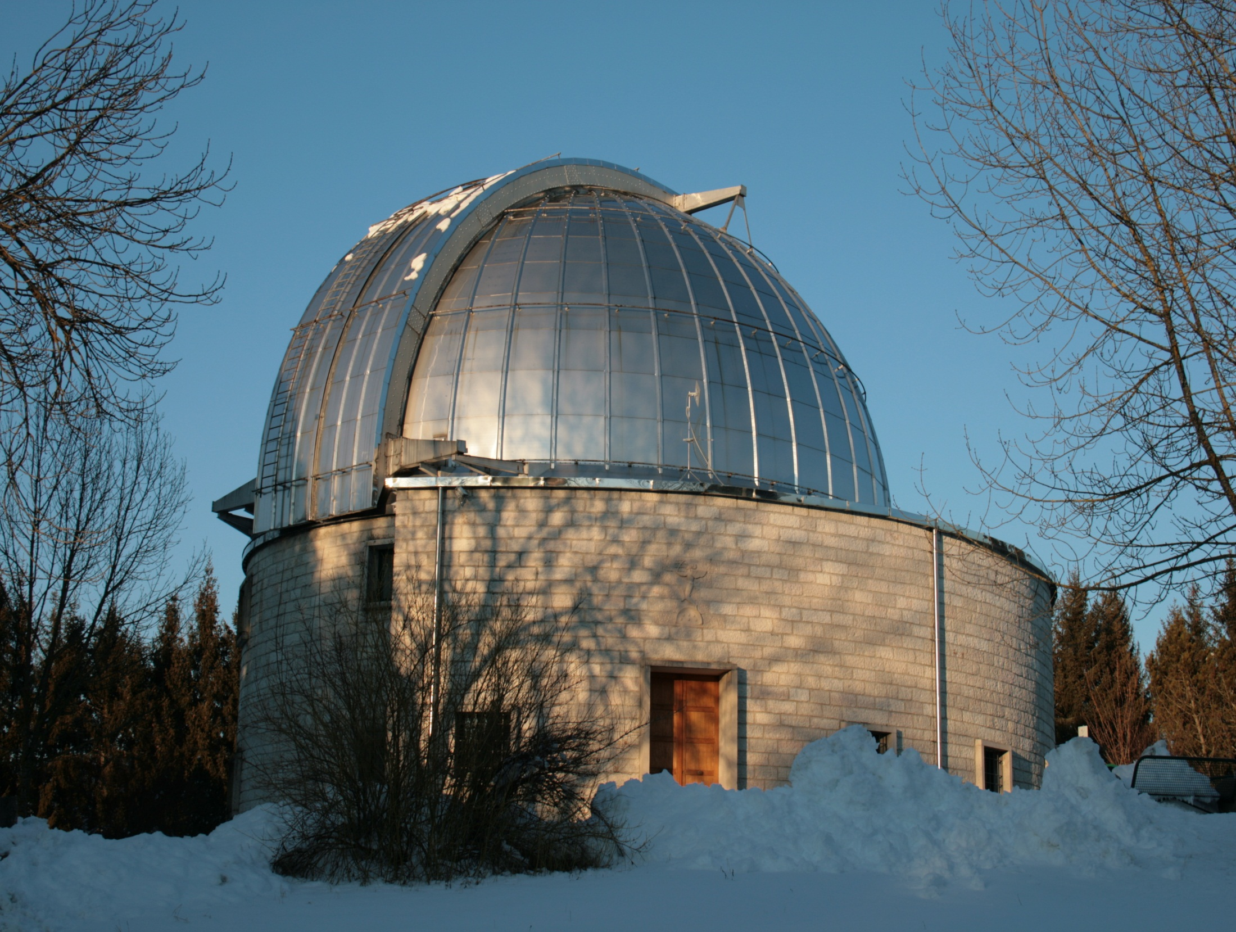
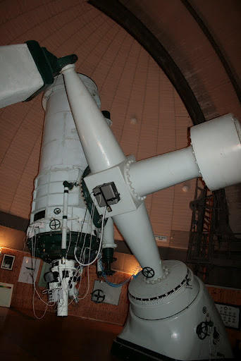

Slide 17
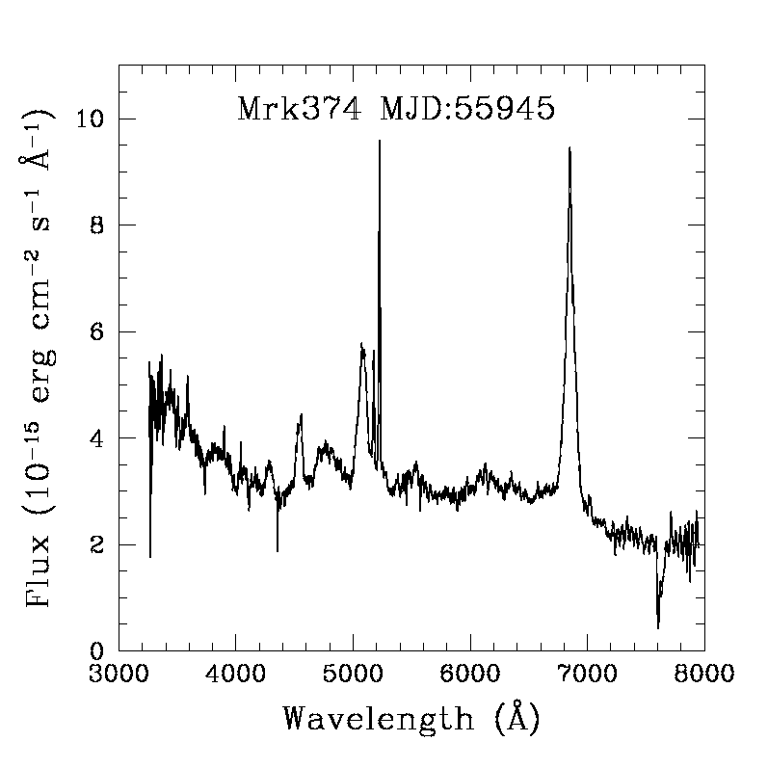
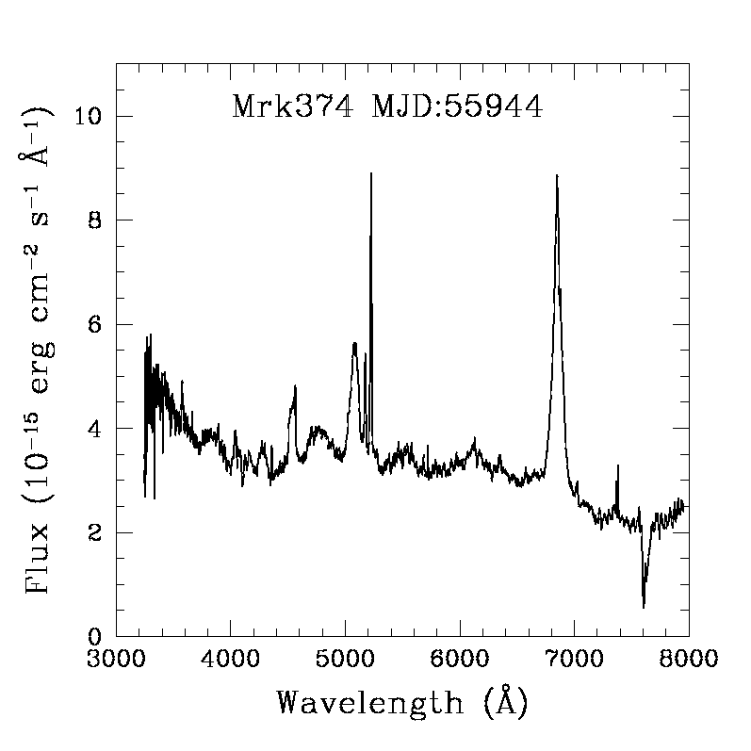
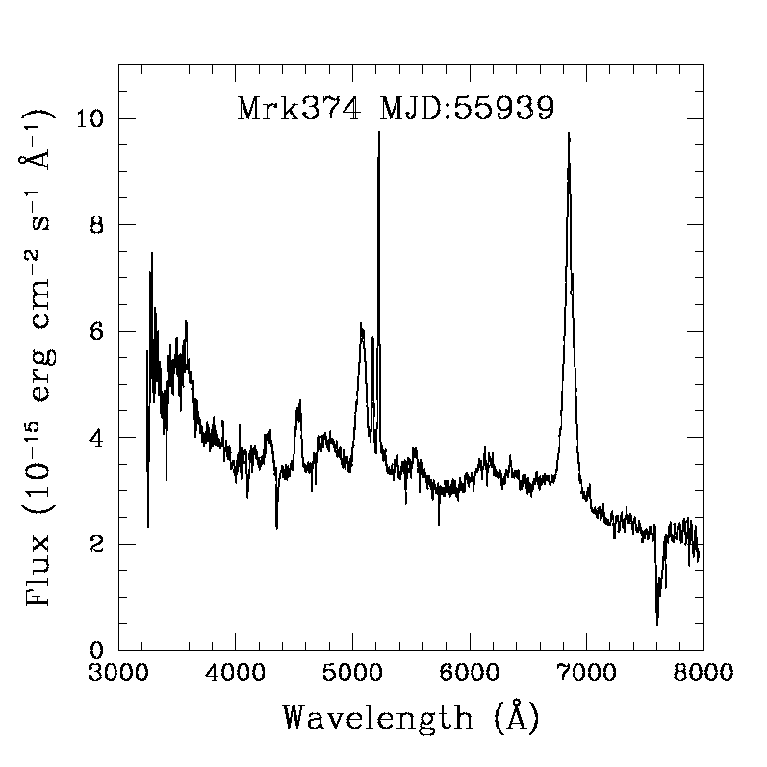
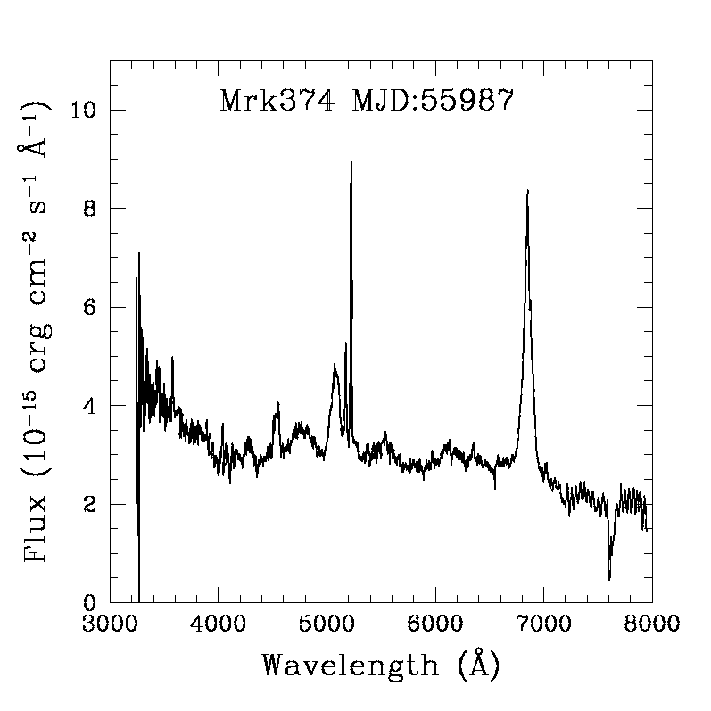
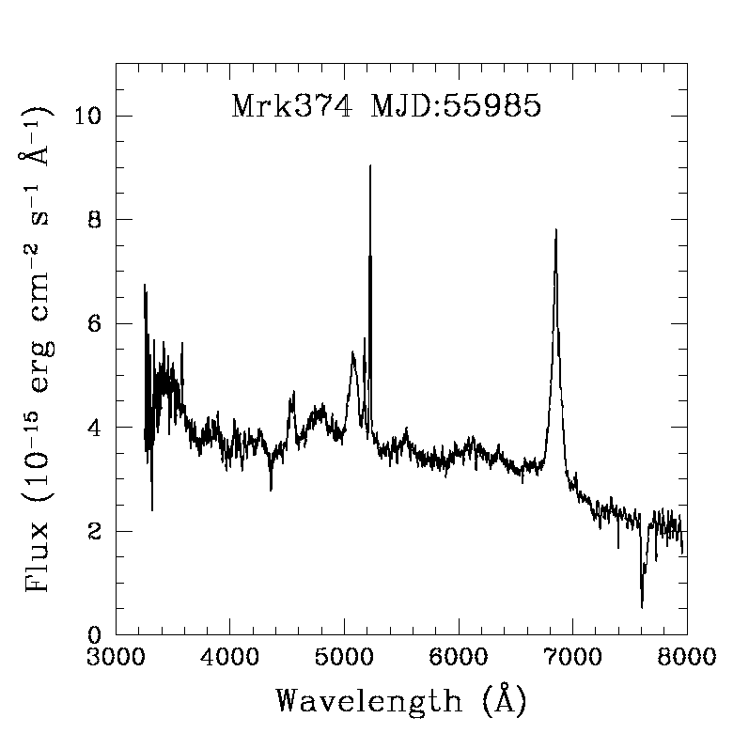
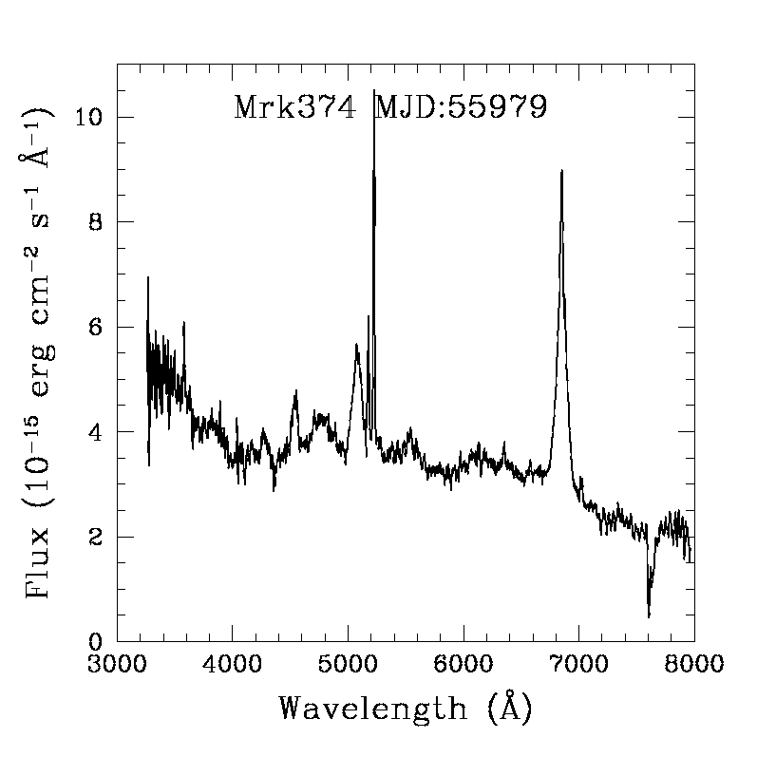
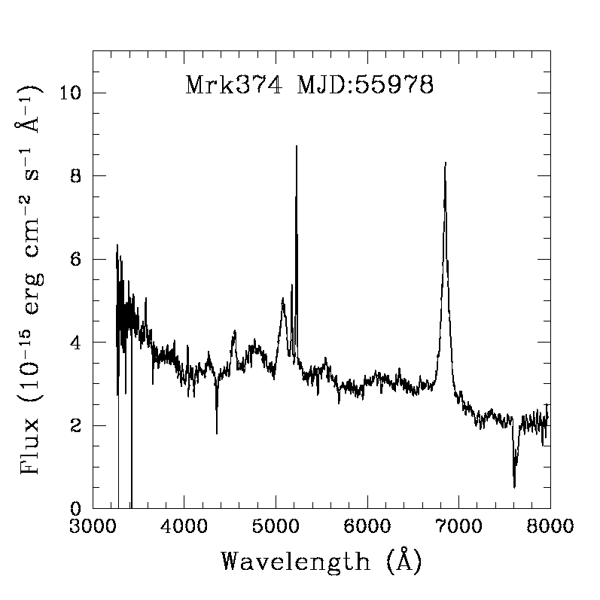
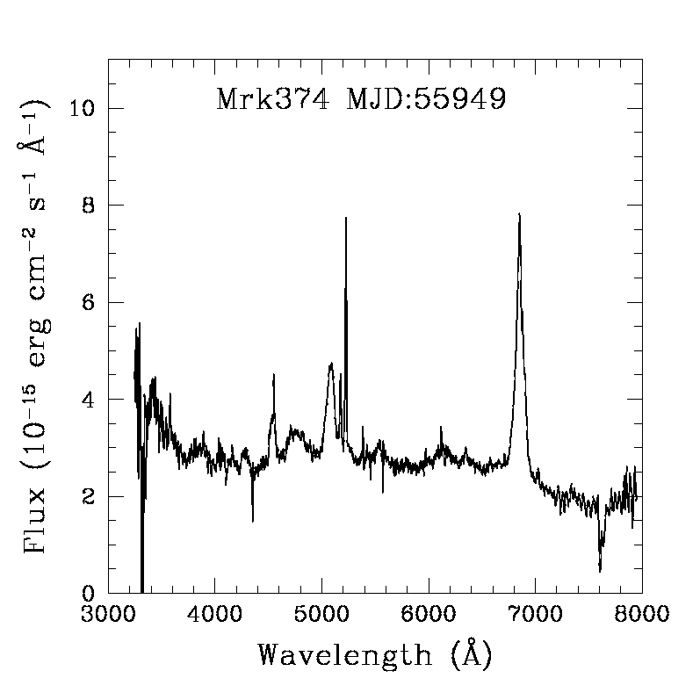

Slide 18
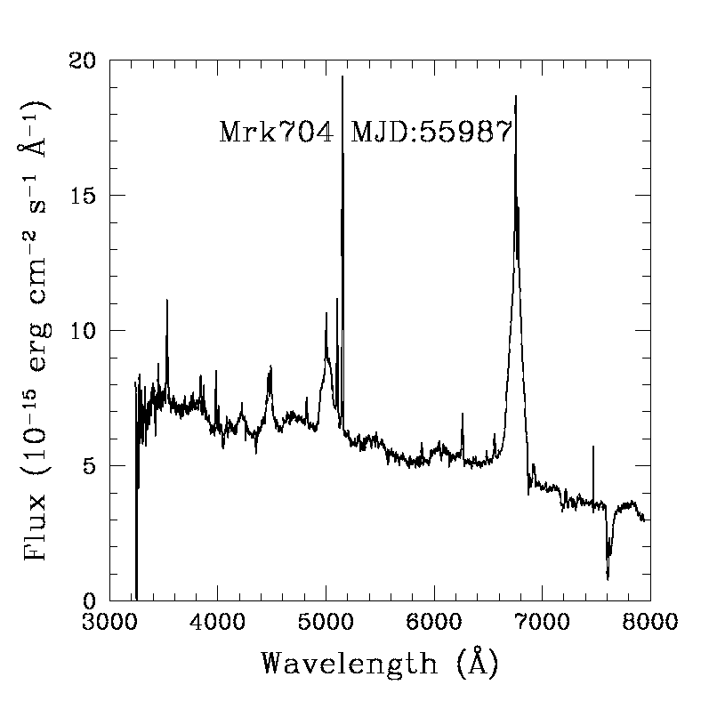
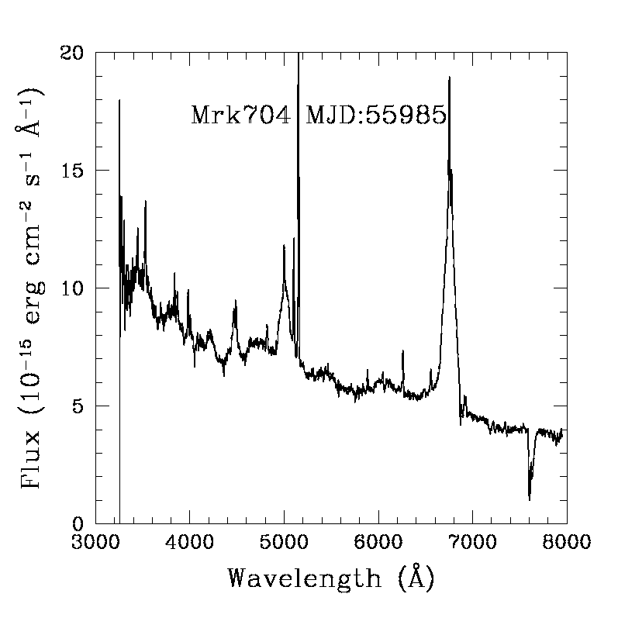
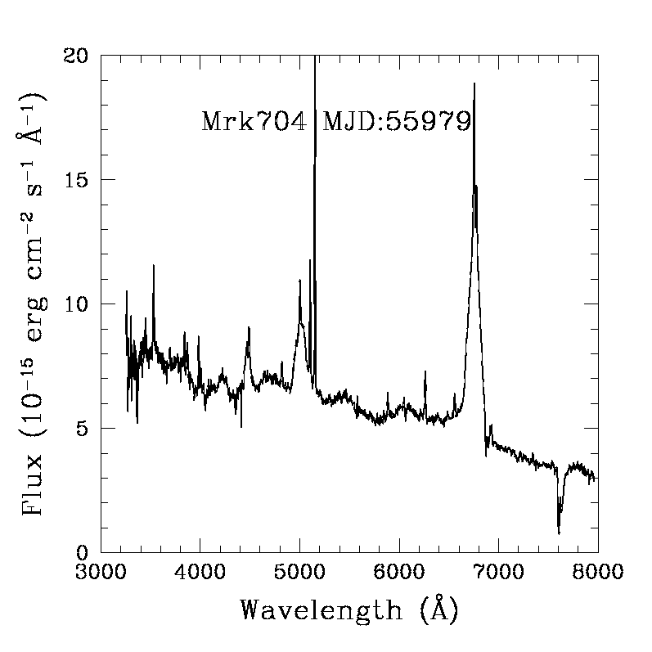
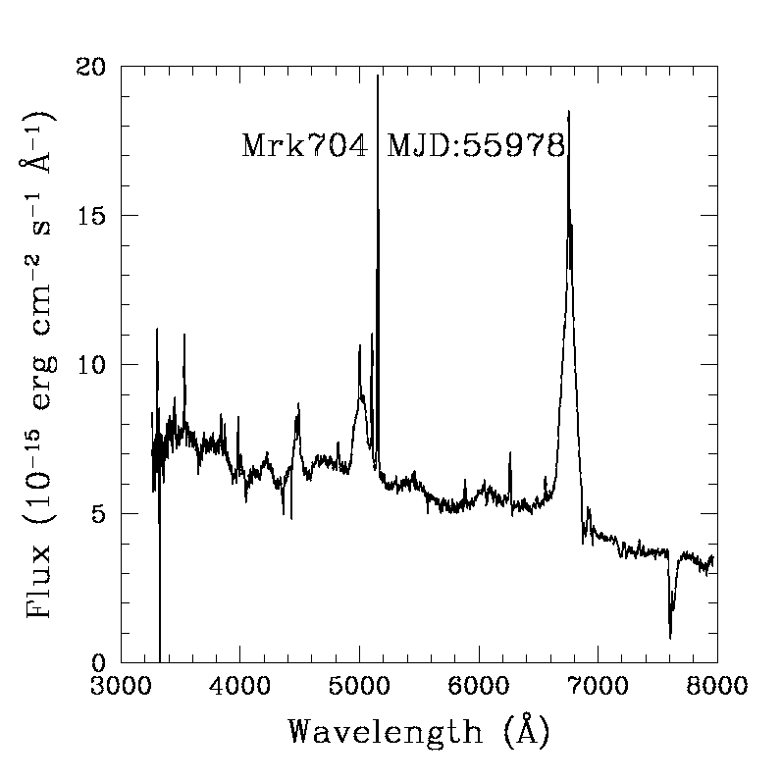
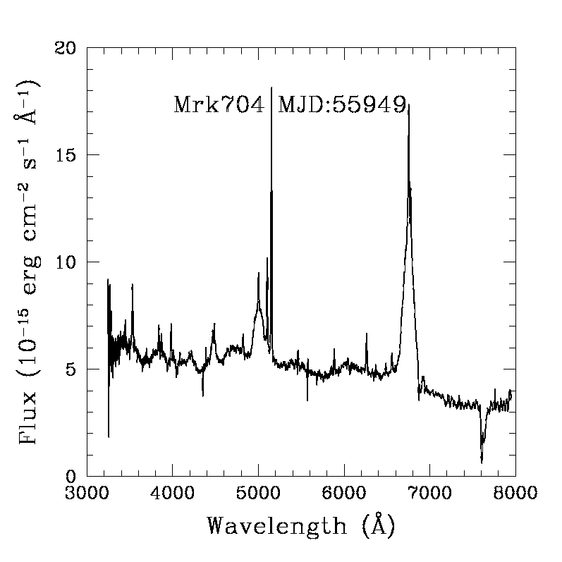
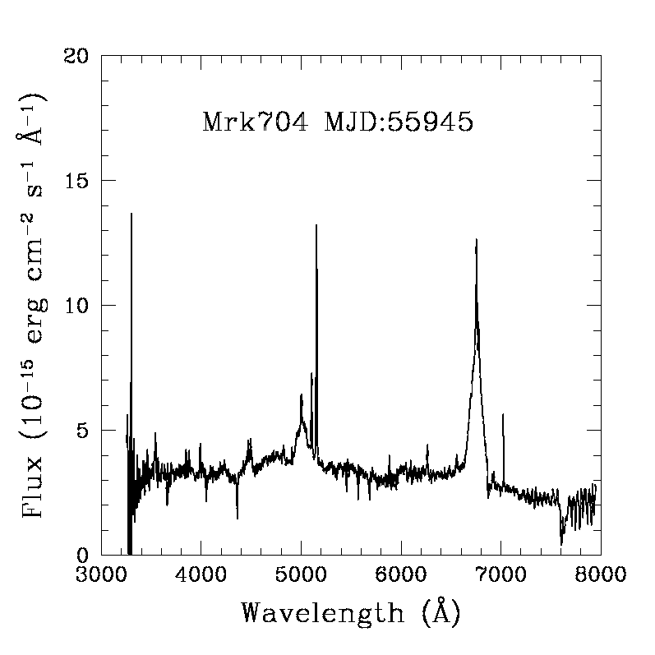
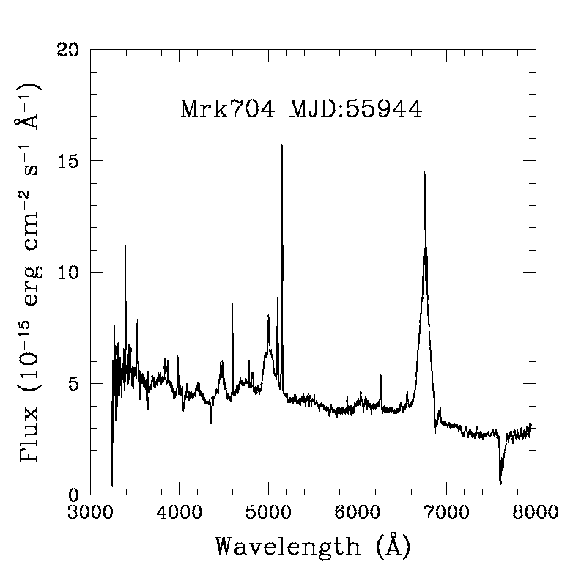

Slide 19
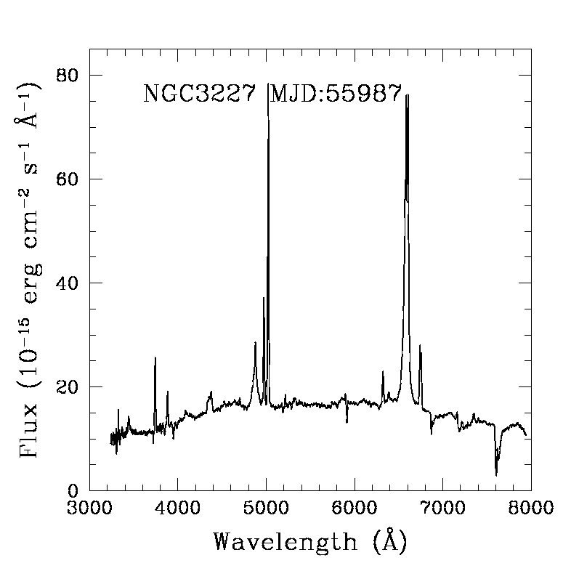
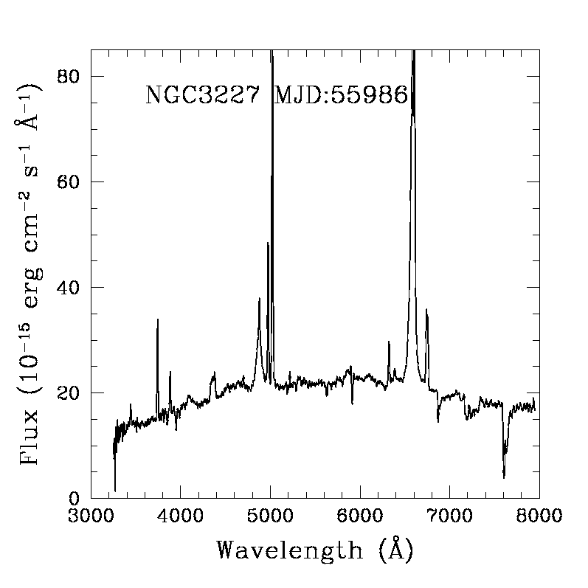
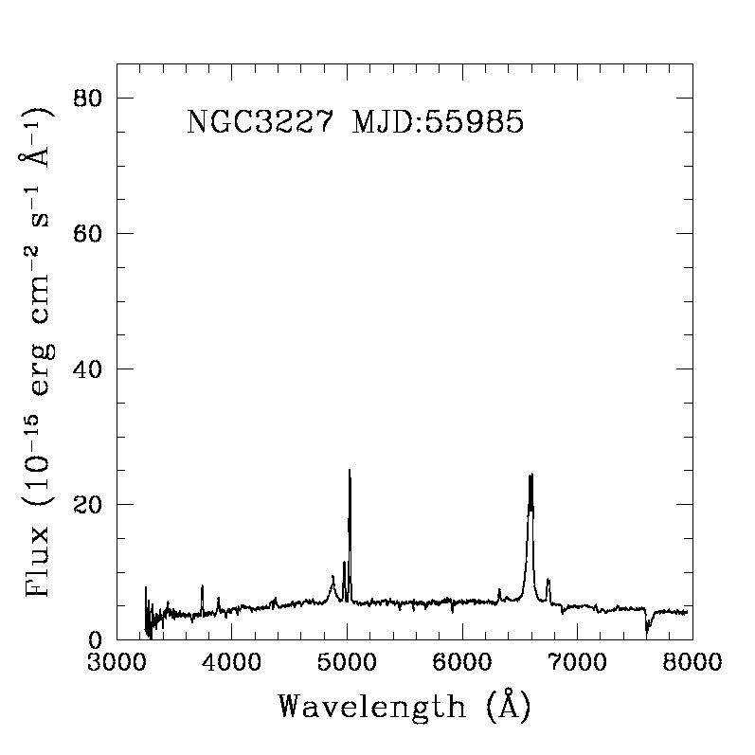
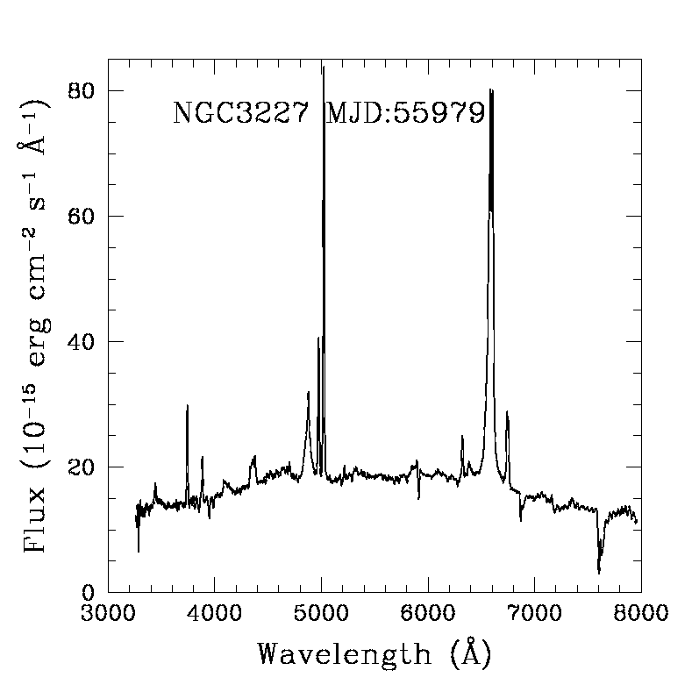
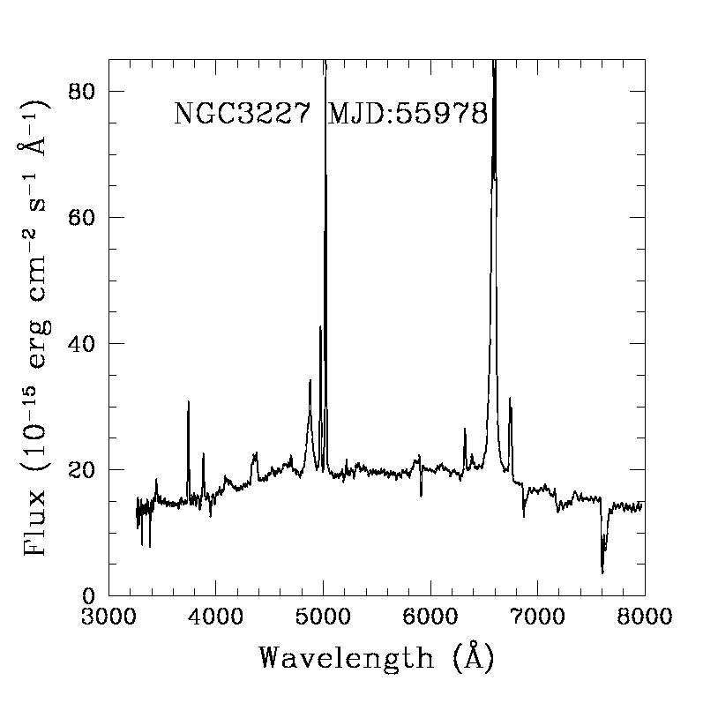
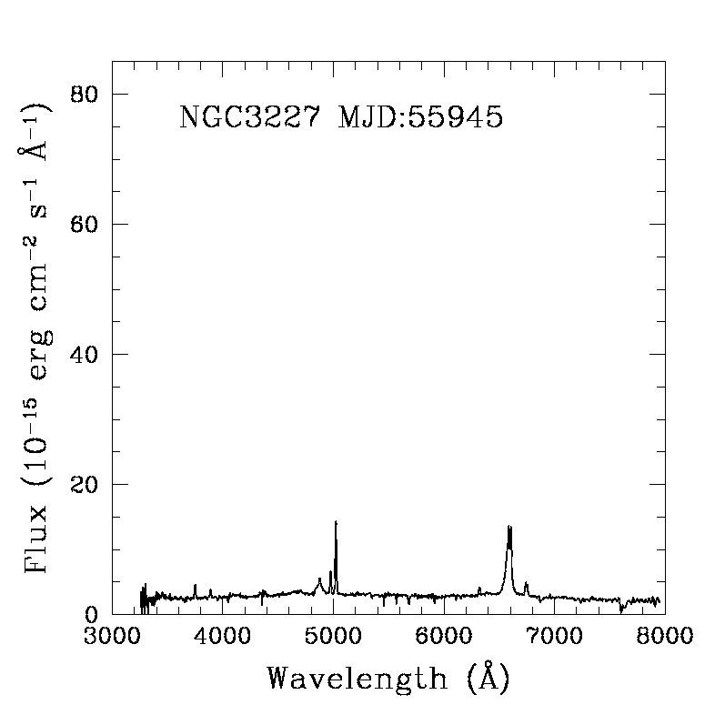

Slide 22
X-ray observations: analysis and results
Flaring particle background can affect the spacecraft, reducing the effective exposure time required for detection of faint objects.
Photon counting pile-up occurs when multiple soft photons are recorded by the detector as a single harder photon.
PG 1352+183 (EPIC – pn)

Slide 23
X-ray observations: analysis and results
The X-ray spectra of BLS1s show a complex thermal component in the soft band, little or no evidence of absorption and a hard X-ray power-law component. A low ionization Fe Kα can usually be detected.

Slide 24
X-ray observations: analysis and results
The X-ray spectra of NLS1s show a complex thermal component in the soft band, no evidence of absorption and the hard X-ray power-law component. The Fe Kα emission line is detected as the product of reflection by a high ionization medium.

Slide 25
Concluding remarks
Using the FWHM of the Hβ emission line as a flag to investigate the degree of ionization, corresponding to the Fe Kα energy, it is found that the degree of matter ionization increases while moving from the domain of BLS1 galaxies to that of NLS1 objects. Indications for an origin of Fe emission in ionized material were already pointed out (Romano et al. 2002, ApJ, 564, 162), but a larger sample of observations is still required to assess whether the degree of ionization is actually connected with the optical emission line profiles, as it is suggested by our preliminary results.

Slide 26
Concluding remarks
Left: The relationship among the hard X-ray power law slope of low redshift Seyfert1 galaxies (open circles) and high redshift QSO (open squares) and the FWHM of the Hβ emission line (Shemmer et al. 2008, ApJ, 682, 81)
Right: Same relationship plotted as a comparison for the sample of Seyfert 1 galaxies studied in this work.

