Slide 1

kinematics of prominence eruptions
X SERBIAN-BULGARIAN ASTRONOMICAL CONFERENCE
30 may – 3 june 2016
Belgrade, serbia
Ts. Tsvetkov, N. Petrov
Institute of astronomy and national astronomical observatory,
Bulgarian academy of sciences
tstsvetkov@astro.bas.bg

Slide 2
outline
Solar prominences
Eruptive prominences
Observational data
EP I:
  AIA/SDO
  LASCO C2/SoHO
  15-cm Lyot Coronagraph, NAO Rozhen
EP II:
  AIA/SDO
  LASCO C2/SoHO
Kinematics
Conclusions & Future work

Slide 3
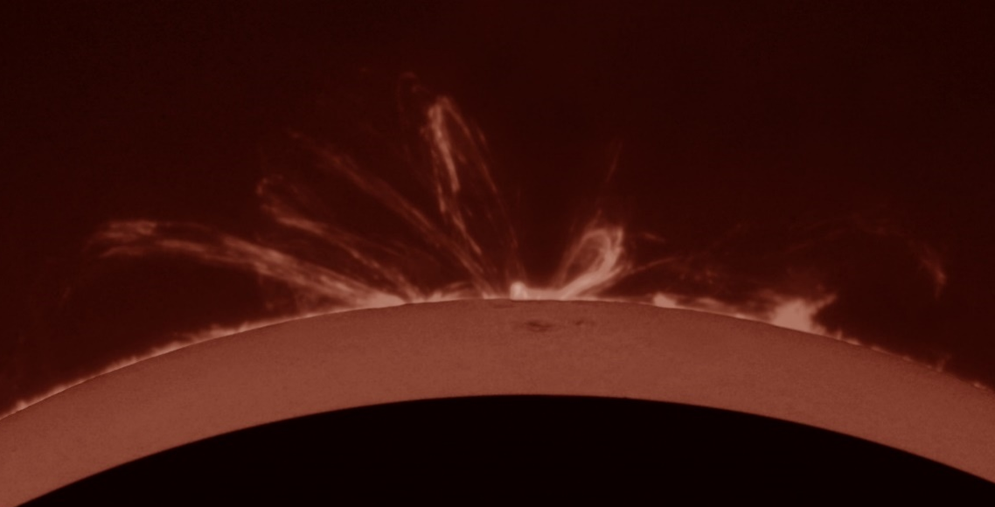
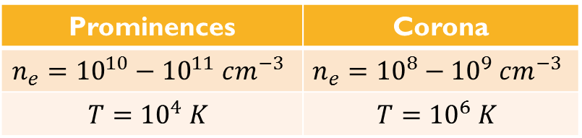
Solar prominences
Denser and cooler than their surroundings (Tandberg-Hanssen, 1995)
In emission above the limb – prominences
In absorption on the solar disk – filaments
Quiescent and Active prominences
Prominences | Corona
$$n_{e}={10}^{10}−{10}^{11} cm^{−3}$$ | $$n_{e}={10}^{8}−{10}^{9} cm^{−3}$$
$$T={10}^{4} K$$ | $$T={10}^{6} K$$

Slide 4
Eruptive prominences
Final or temporary phase of а QP development
Huge magnetic system (HMS; Rompolt, 1984)
Eruption types (Gilbert et al., 2007):
 | Eruption types | Description
1 | Full | At least 90% of filament mass and magnetic structure escapes the Sun
2 | Partial | (a) Entire magnetic structure erupts with some or none of the filament mass (as a result of mass draining)
 |  | (b) Partial eruption of the magnetic structure with some or none of the filament mass (as a result of mass draining and/or settling)
3 | Confined | None of the filament mass nor the magnetic structure escapes the Sun
Full eruption
Confined eruption
Partial eruption

Slide 5
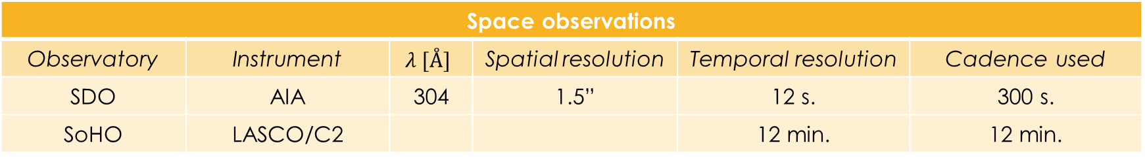
Observational data
EP I: 6th June 2011 (CR 2111), 03:30-12:00 UT
First appearance: 1st June (01:00 UT)
Not associated with an active region
SW limb
Full eruption
Associated CME
EP II: 27th Feb 2013 (CR 2134), 00:00-12:30 UT
First appearance: 25th Feb (00:00 UT)
Not associated with an active region
SW limb
Full eruption
Associated CME
Space observations
Observatory | Instrument | $$λ [Å]$$ | Spatial resolution | Temporal resolution | Cadence used
SDO | AIA | 304 | 1.5” | 12 s. | 300 s.
SoHO | LASCO/C2 |  |  | 12 min. | 12 min.
SolarSoftware/IDL

Slide 6
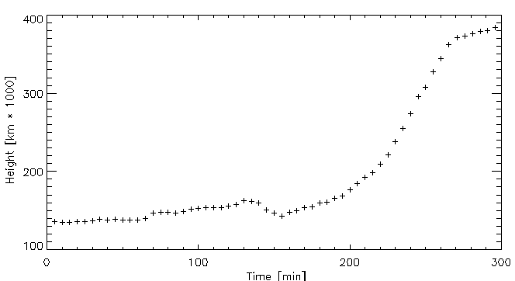
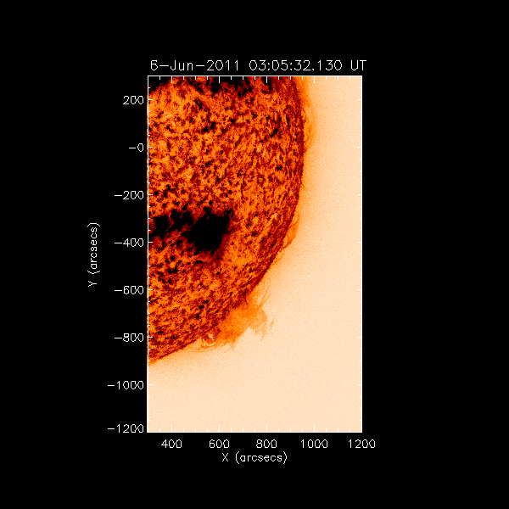

EP I: 6 June 2011
AIA/SDO 304 $Å$
Height-time profile of the 6 June 2011 prominence (AIA/SDO 304 $Å$)
03:00-8:00 UT (t ~ 5 h)
H [km*10³] = 130 ÷ 385

Slide 7
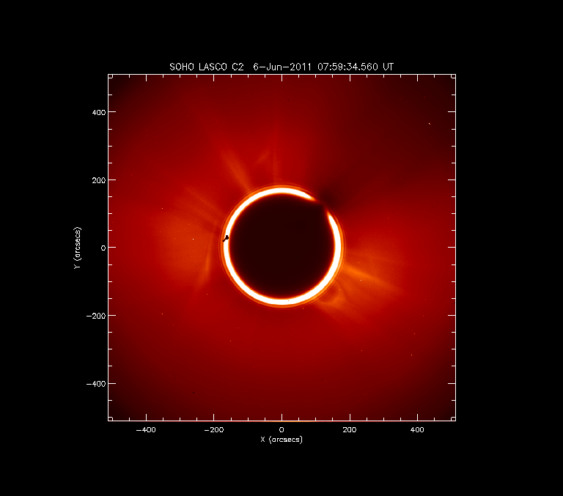
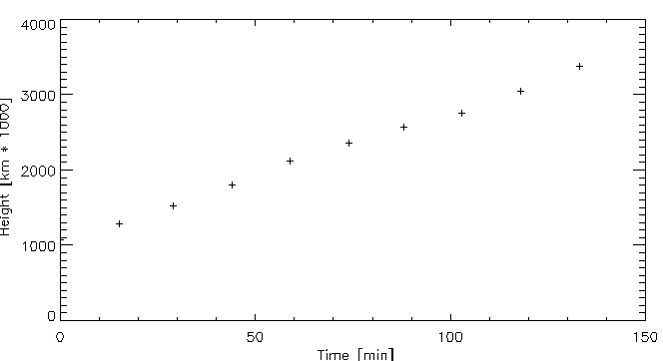
EP I: 6 June 2011
LASCO C2/SoHO
Height-time profile of the 6 June 2011 prominence (LASCO C2/SoHO)
08:00-11:00 UT (t ~ 3 h)
H [km*10³] = 1080 ÷ 3385

Slide 8
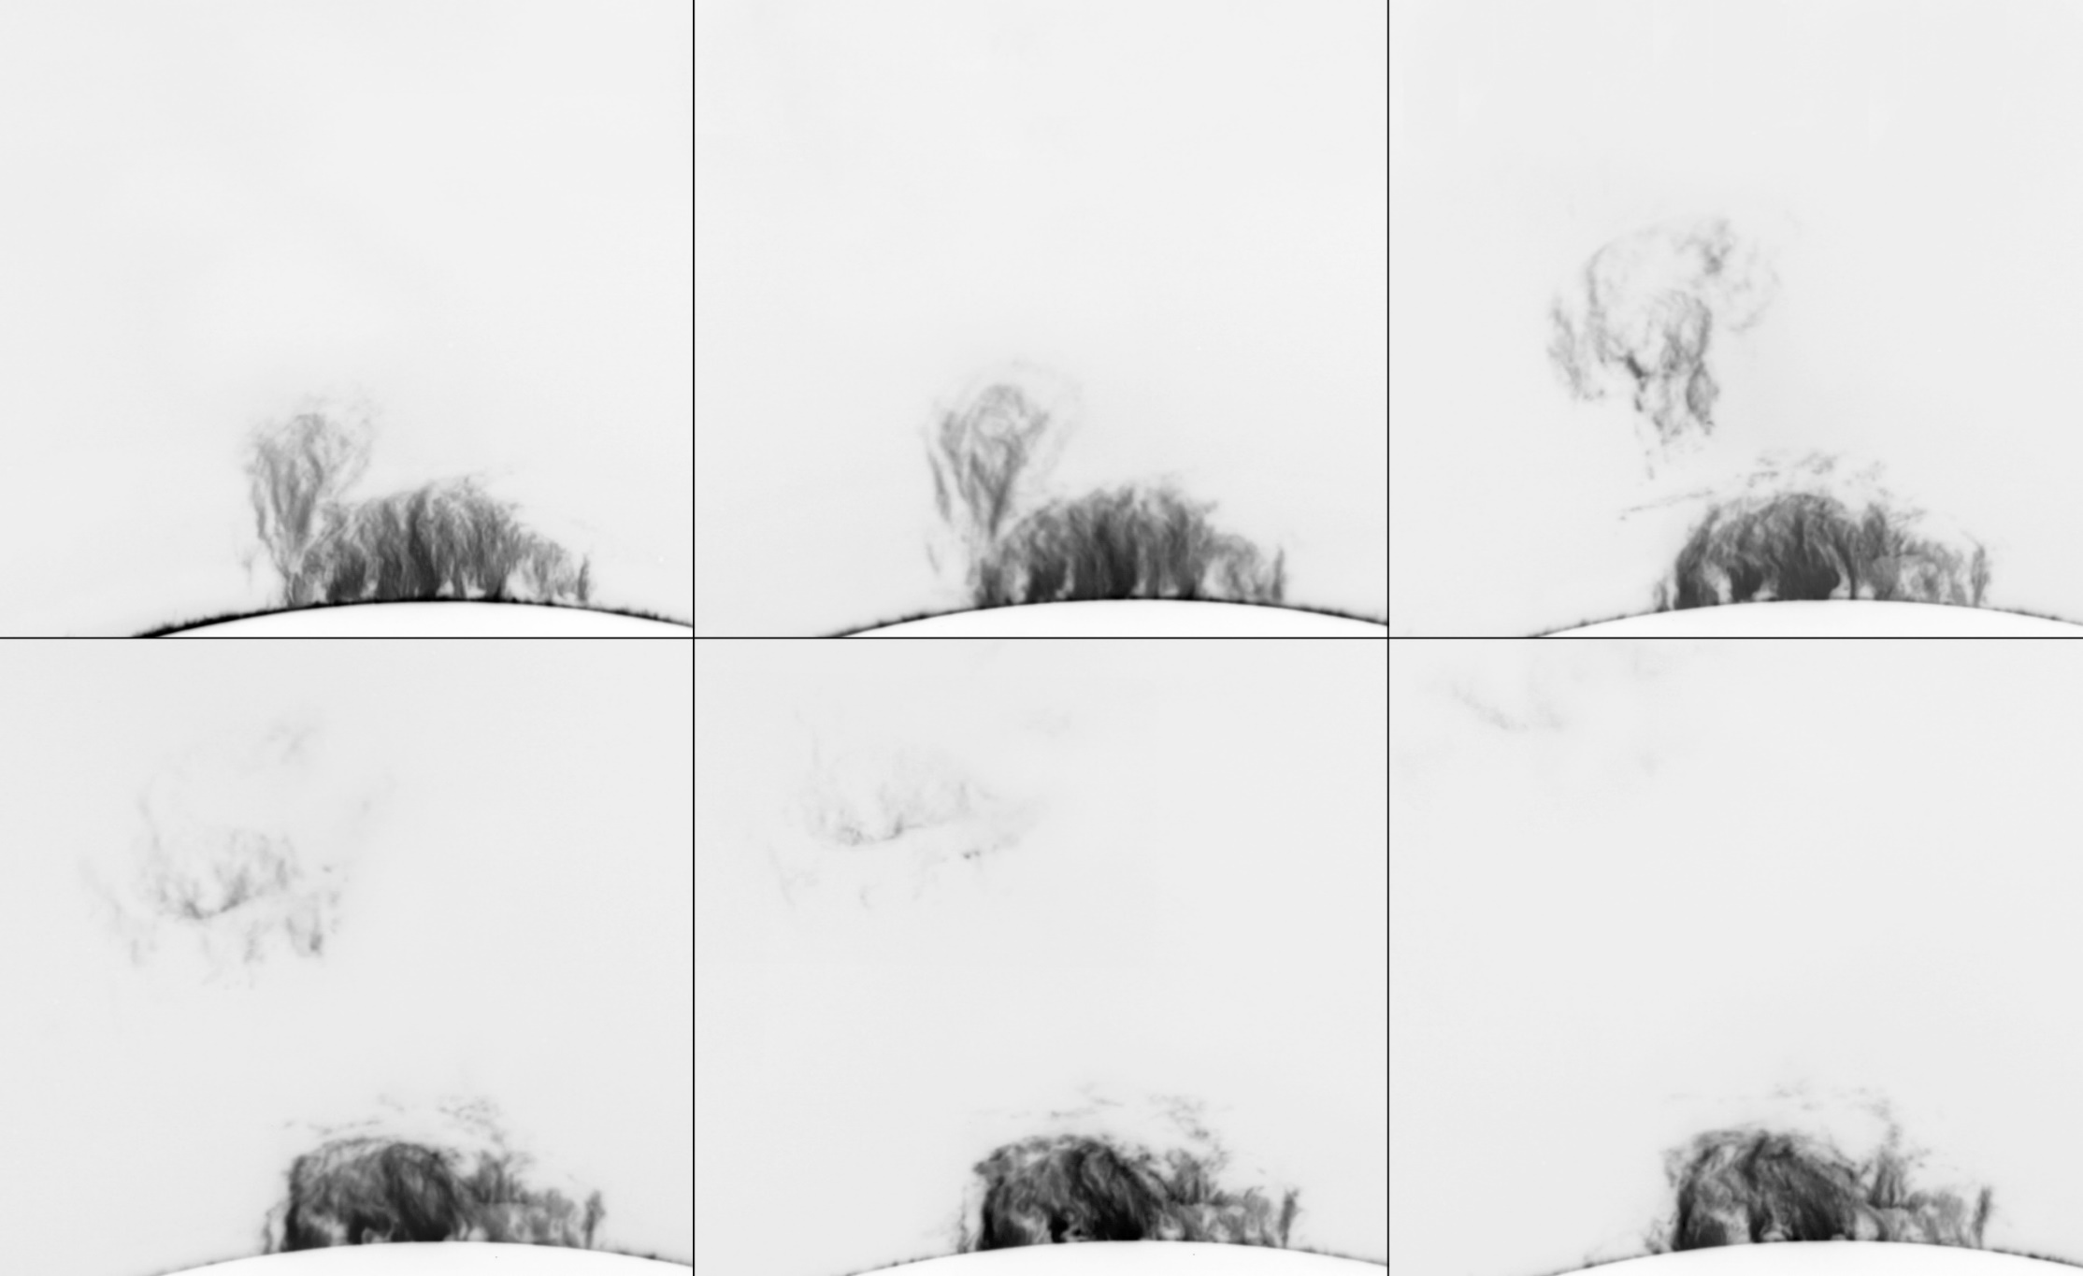
15-cm CORONAGRAPH, NAO ROZHEN
05:00-06:40 UT

Slide 9
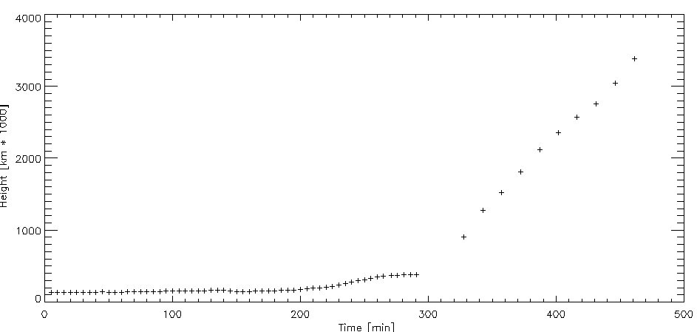
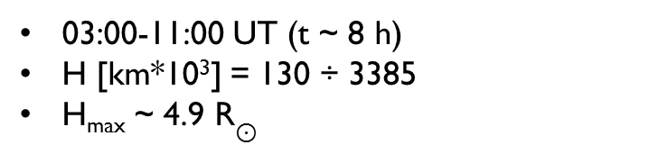



Kinematics 6 June 2011
03:00-11:00 UT (t ~ 8 h)
H [km*10³] = 130 ÷ 3385
H_{max} ~ 4.9 R$⊙$
$$v_{3}=443 km/s$$
$$v_{2}=23.3 km/s$$
$$v_{1}=4.0 km/s$$

Slide 10
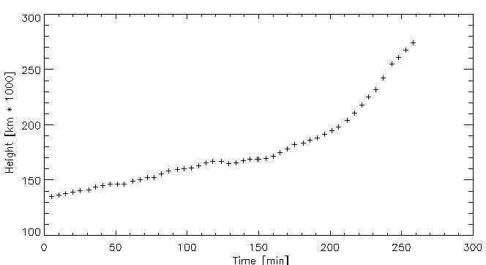
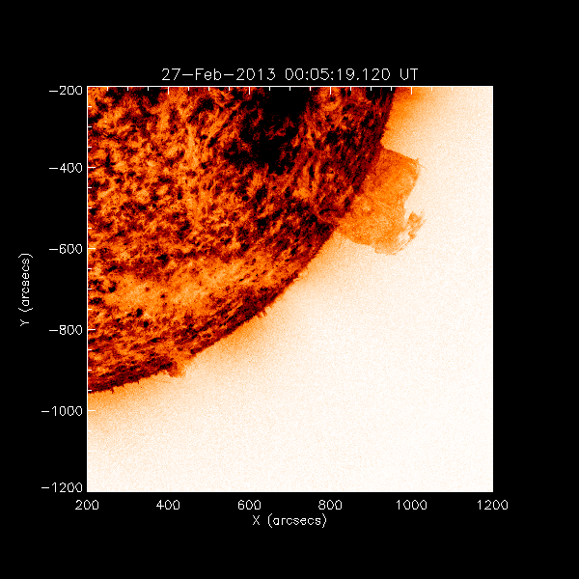

EP II: 27 FEB 2013
AIA/SDO 304 $Å$
Height-time profile of the 27 Feb 2013 prominence (AIA/SDO 304 $Å$)
00:00-05:30 UT (t ~ 5.5 h)
H [km*10³] = 135 ÷ 275

Slide 11
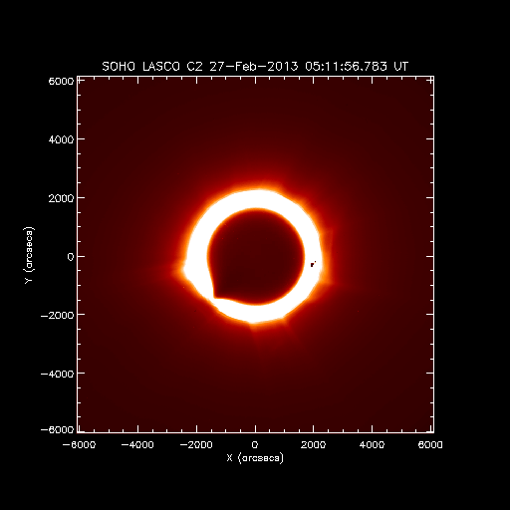
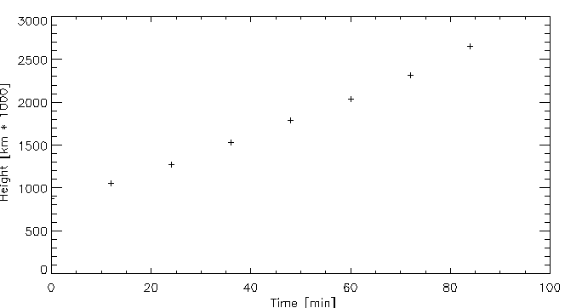
EP II: 27 FEB 2013
LASCO C2/SoHO
Height-time profile of the 27 Feb 2013 prominence (LASCO C2/SoHO)
05:00-07:30 UT (t ~ 2.5 h)
H [km*10³] = 880 ÷ 2700

Slide 12
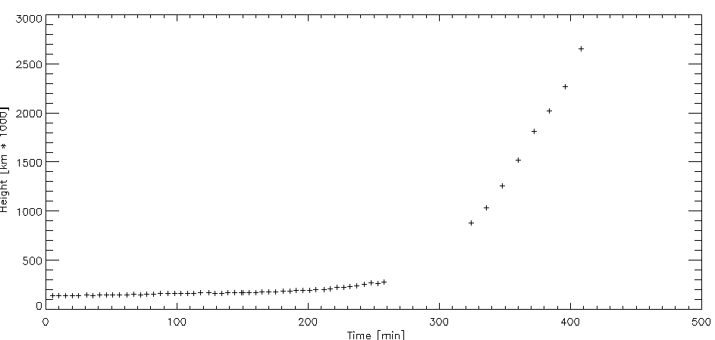
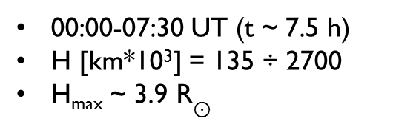



Kinematics 27 FEB 2013
00:00-07:30 UT (t ~ 7.5 h)
H [km*10³] = 135 ÷ 2700
H_{max} ~ 3.9 R$⊙$
$$v_{3}=536 km/s$$
$$v_{2}=23.4 km/s$$
$$v_{1}=5.1 km/s$$

Slide 13
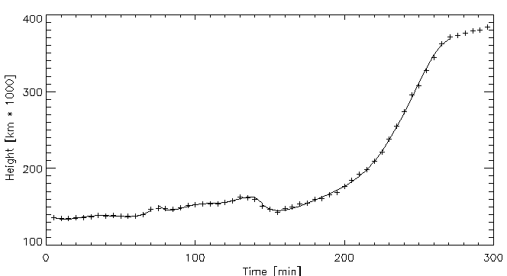
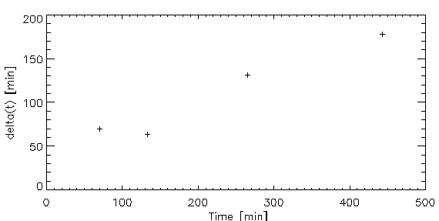
Kinematics
6 June 2011
6/6/2011
t_{max} | ∆t
70 | 70
133.539 | 63.539
265.093 | 131.554
443.001 | 177.908

Slide 14
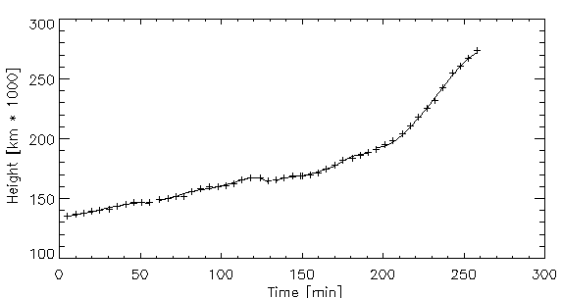
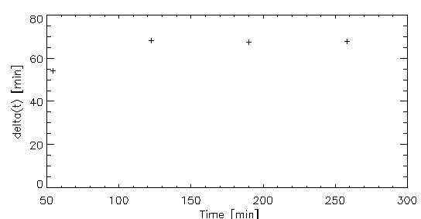
Kinematics
27 FEB 2013
27/2/2013
t_{max} | ∆t
54.2242 | 54.2242
122.551 | 68.3268
190.059 | 67.508
257.969 | 67.910

Slide 15
Conclusions & Future Work
The PEAKS IN AIA/SDO height-time profiles
POSSIBLE EXPLANATIONS:
  Interaction between the solar wind and prominence material (Shock waves)
  Waves, propagating through the corona
  HMS resistance
  Solar oscillations (helioseismology)
UNDERSTANDING THEIR NATURE, EXPLORING THEIR CHARACTERISTICS

Slide 16
REFERENCES
Gilbert, H. R., Alexander, D., Liu, R.: 2007, Solar Phys. 245, 287.
Rompolt, B.: 1984, Adv. Space Res. 4, No. 4, 357.
Tandberg-Hanssen, E. : 1995,The Nature of Solar Prominences, Astrophysics and Space Science Library 199, Dordrecht, Holland.

Slide 17
THANK YOU!

