Slide 1
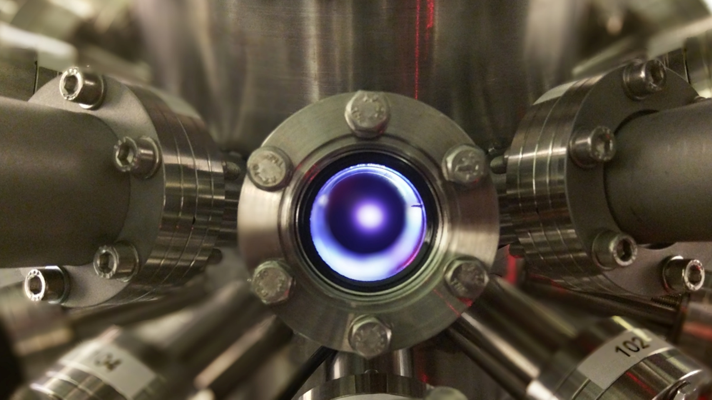

Spectroscopic studies on Sn plasmas:
The optical spectrum of SnIV
Joris Scheers
EUV Plasma Processes
Advanced Research Center for Nanolithography

Slide 2
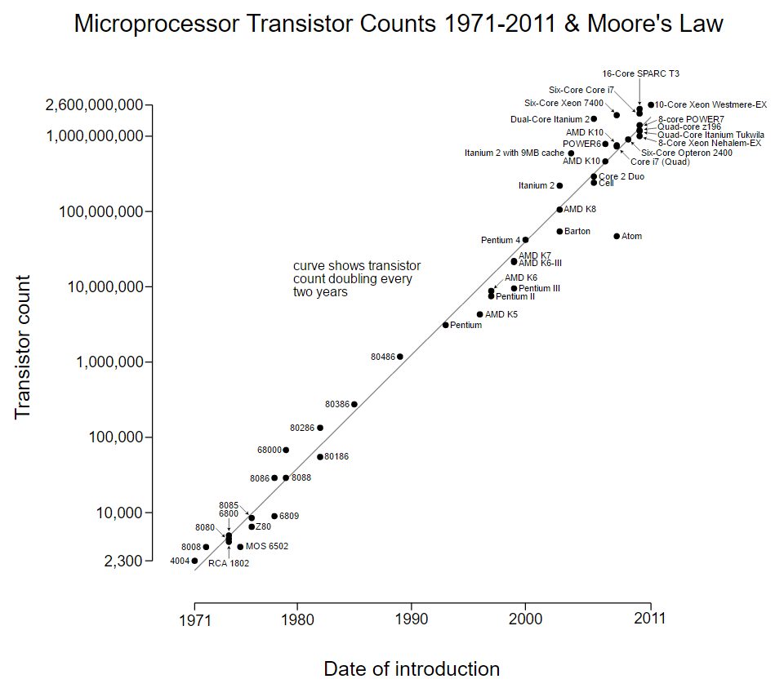
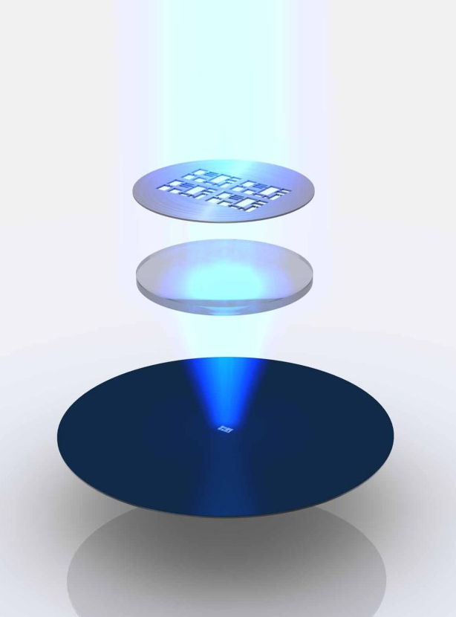
Introduction
Source: Wikimedia Commons
Source: bit-tech.net

Slide 3
Tin droplets for EUV generation
Multi-layer collector mirror
Tin droplets
EUV focus
High-intensity laser beam
  Sn⁷⁺ - Sn¹⁰⁺
Torretti et al, Phys. Rev. A. 95, 042503 (2017)
  Sn¹¹⁺ - Sn¹⁴⁺
Windberger et al, Phys. Rev. A. 94, 012506 (2016)

Slide 4
Lowly charged tin ions
  Study on plasma parameters
  Stark broadening (n_{e}, T)
    Laser parameters (λ, t_{p})
    Buffer gasses
    …
E. Kieft et al, Phys. Rev. E. 70, 066402 (2004)
S. Djeniže, Spectr. Act. B 62, 403-409 (2007)
M. Burger et al, Publ. Astr. Obs. Belgr 91, 53-56 (2012)
N. Konjević et al, J. Phys. Chem. Ref. Data 31, 819 (2002)
Z. Simić et al, Publ. Astr. Obs. Belgr 84, 487-490 (2008)
A. Alonso-Medina et al, MNRAS 414, 713-726 (2011)
I. de Andres-Garcia et al, MNRAS 455, 1145-1155 (2016)
B. Martinez et al, J. Phys. B: AMOP 32, 241-247 (1999)
…
Kurilovich et al, Phys. Rev. Applied. 6, 014018 (2016)

Slide 5
Experimental spectrum

Slide 6
SnIV example
6s ²S_{1/2} – 6p ²P_{1/2}

Slide 7
Line masks
5p² ¹S₀ – 5p6s ¹P₁
5d ²D_{5/2} – 4f ²F_{7/2}
6s ¹S₀ – 6p ¹P₁
6s ²S_{1/2} – 6p ²P_{1/2}
6s ³D₃ – 6p ³F₄

Slide 8
Normalization by continuum

Slide 9
Charge state identification
Scaling method applied to experimental spectrum:
20 SnIV lines readily assigned to known lines found in literature
 | #
SnI | 35
SnII | 39
SnIII | 76
SnIV | 43
SnV | 86
Literature: C.E. Moore, NBS Circ. 467, Vol. III, 1958 (NIST database)
A. N. Ryabtsev et al, Opt. i. Spekt 100, 2006

Slide 10
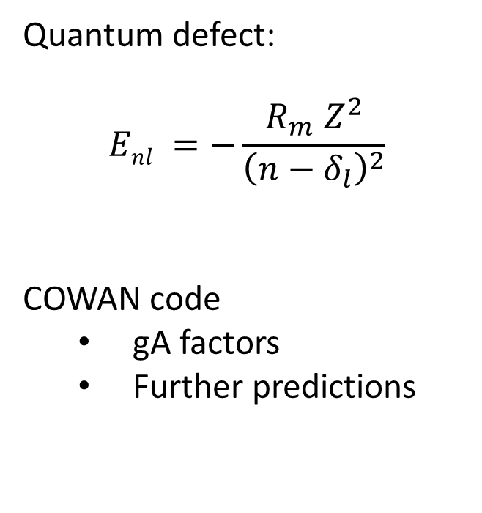
Charge state identification
Quantum defect:
$$Enl =−\frac{R_{m} Z^{2}}{{\left(n−δ_{l}\right)}^{2}}$$
COWAN code
  gA factors
  Further predictions
B. Edlen, Handbuch der Physik, Spektroskopy (1964)
COWAN: Collaboration with A. N. Ryabtsev, ISAN Russia
Literature: C.E. Moore, NBS Circ. 467, Vol. III, 1958 (NIST database)
A. N. Ryabtsev et al, Opt. i. Spekt 100, 2006
Preliminary

Slide 11
Anomalous fine structure of 5d
Shift of 5d_{5/2} due to configuration interaction with 4d⁹5s² is -615 cm⁻¹
 | △E_{5d} (cm⁻¹)
ARCNL | -105
NIST | -106
RMBPT | -745
CI+MBPT: Collaboration with J. Berengut, UNSW Australia
RMBPT: U. I. Safronova et al, Phys. Rev. A. 68, 062505 (2003)
Moore: Experimental levels from C.E. Moore, NBS Circ. 467, Vol. III (1958)
Preliminary

Slide 12
Identification of the 5f level
Level found by denoting transitions from 7d to 5f, and from 5f to 6d.
Possible configuration interaction with (multiple) 5s5p levels;
First results indicate large shift
 | △E_{5f} (cm⁻¹)
ARCNL | -308
RMBPT | -44
RPTMP | -22
CI: Collaboration with J. Berengut, UNSW Australia
RMBPT: U. I. Safronova et al, Phys. Rev. A. 68, 062505 (2003)
RPTMP: E.P. Ivanova, At. Data and Nucl. Data Tab. 97, p1-22 (2011)
Preliminary

Slide 13
Conclusions
Using charge scaling method categorized lines
Extended level structure of SnIV
Outlook
Plasma characterization

Slide 14
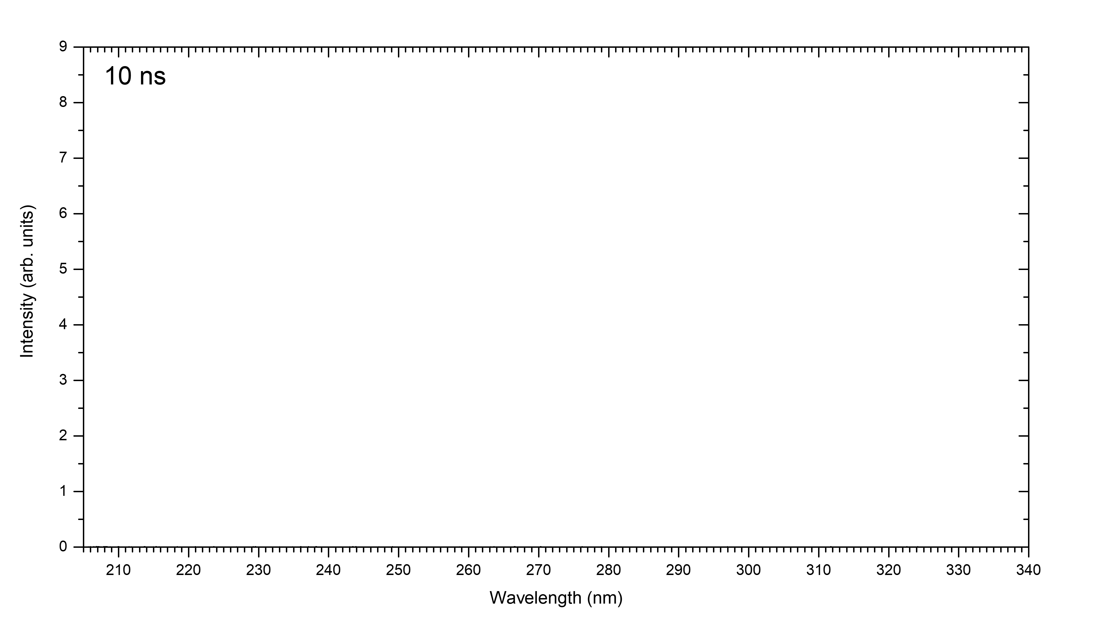
Time-resolved optical spectroscopy

Slide 15















Acknowledgements
PhD students:
D. Kurilovich
F. Torretti
R. Schupp
J. Scheers
Collaborators:
A. N. Ryabtsev (ISAN Moscow, Russia)
J. Berengut (UNSW Sydney, Australia)
A. Borschevsky (University of Groningen)
Postdoc:
A. Bayerle
Group leaders:
O. O. Versolato
W. Ubachs
R. Hoekstra

